Slide 1

NIH Small Business Programs
Chris Sasiela, PhD, RAC
chris.sasiela@nih.gov
Small business Education and Entrepreneurial Development office
Office of Extramural Research, NIH

Slide 2
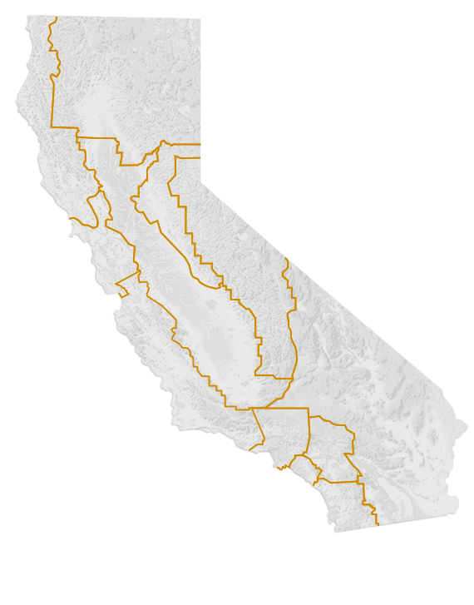
SB program = Local investment
In FY18, CA small businesses received
>$200M
in NIH SBIR/STTR funding.
>$31M
Awarded to
Bay Area
companies.
San Francisco area
$31.6 M
LA/OC area
$26.1 M
San Diego area
$60.6 M
Source: NIH RePORTER

Slide 3
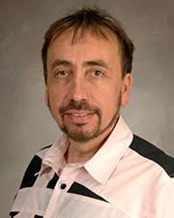


STTR Innovation
Chief Scientific Officer, Co-founder
Claudio Soto, PhD
Professor, Department Of Neurology
20 yrs, 56 projects, >$37M in NIH support
Including 6 STTR awards >$4.5M
Breaking News! Amprion Receives FDA Breakthrough Device Designation For Detection of Alpha-Synuclein
https://www.amprionme.com

Slide 4



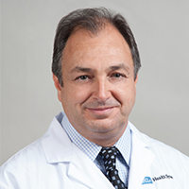
SBIR/academic innovation
Data Driven Drug Design ®
Dr. Ricardo Olcese
16 yrs academic research on calcium channel modulation
5 NIH SB awards (10 yrs) STTR: NIDDK
SBIR: NIAMS, NHLBI
SBIR Phase I award: in silico modelling of calcium channel moderators
SBIR Phase II award: medicinal chemistry lead development and preliminary efficacy testing

Slide 5



SBIR/STTR Program Phases
Phase I Feasibility Study
Budget Guide: $252K for SBIR and STTR
Project Period: 6 months (SBIR); 1 year (STTR)
6 page research plan
Phase
I
Discovery
Phase II Full Research/R&D
$1.68M for SBIR and STTR, over two years
12 page research plan
12 page commercialization plan
Phase
II
Development
Phase IIB Competing Renewal/R&D
Clinical R&D; Complex Instrumentation/to FDA
Many, but not all, IC’s participate
Varies~$1M per year; up to 3 years
Phase
IIB
Phase III Commercialization
NIH, generally, not the “customer”
Consider partnering and exit strategy early
Phase
III
Commercialization

Slide 6
Types of applications
Phase I
  proof of concept
Phase II following Phase I
Fast Track
  combined Phase I and II (12 page research plan)
Direct to Phase II (SBIR only)
  Phase I equivalent work completed without SB funding
Budget Waiver Topics
Commercialization Readiness Pilot (Phase 2 awarded)

Slide 7
SBIR or STTR?
 | SBIR (3.2%, $1B) | STTR (0.45%, $144M)
Partnering Requirement | Permits partnering | Requires a non-profit research institution partner (e.g. university)
Work Requirement | Guidelines: May outsource 33% (Phase I) 50% (Phase II) | Minimum Work Requirements: 40% small business 30% research institution partner
Principal Investigator | Primary employment (>50%) must be with the small business | May be employed by either the research institution partner or small business
Award is always made to the small business

Slide 8
Omnibus Grant Solicitations
NIH, CDC, & FDA SBIR/STTR Grant Solicitation “Parent” FOAs:
https://sbir.nih.gov/funding#omni-sbir
Clinical Trial Required
  SBIR: PA-19-273 STTR: PA-19-271
  Clinical Trial Not Allowed
SBIR: PA-19-272 STTR: PA-19-270
Release Date: May 7, 2019
Receipt Dates: January 6, April 6 (2020)

Slide 9
Clinical Trial?
Is Your Study an
NIH-defined Clinical Trial
Does your study…
Involve one or more human participants?
Prospectively assign human participant(s) to intervention(s)?
Intend to evaluate the effect of an intervention on human participants
Have a health-related biomedical or behavioral outcome?
If “yes” to ALL of these questions, your study is considered a clinical trial
Clinical Trial Interactive Decision Tree:
https://grants.nih.gov/ct-decision/index.htm

Slide 10
Annual Contract Solicitation
NIH / CDC SBIR Contract Solicitation
https://sbir.nih.gov/sites/default/files/PHS2020-1.pdf
NIH participation: NCATS, NCI, NHLBI, NIAAA, NIAID
CDC participation: NCCDPHP, NCEH, NCEZID, NCIRD
Receipt Date: October 23, 2019 5:00pm EDT

Slide 11
Commercialization Readiness
Pilot Program (Phase II predicate)
Technical Assistance and Late Stage Development
Clinical Trial Not Allowed
SBIR: PAR-19-333
Technical Assistance and Late Stage Development
Clinical Trial Required
  SBIR: PAR-19-335
  Technical Assistance Clinical Trial Not Allowed
SBIR: PAR-19-334
Not all IC’s participate; no uniform budget limit; no additional TABA
Competitive Revision/Supplement to an active Phase II/IIB award OR a renewal of a closed Phase II/IIB award.
Notes:
CRP awards can either be a "Type 3" Revision (Competitive Revision/Supplement) to a currently active Phase II or Phase IIB award or can be a "Type 2" Renewal of a Phase II or IIB SBIR/STTR award that has ended and is closed out.
NOT ALL IC’s accept applications
Each participating IC may have budget constraints
CRP does not allow TABA addition to budget

Slide 12
Application → Funding
Receipt
Date
Scientific
Review
Council
Review
Award
Date
(earliest)
April 5th
Sept 5th
Jan 5th
May/June
Oct/Nov
Feb/Mar
Aug/Sept
Jan/Feb
May/June
October
March
July
Notes:
12
12

Slide 13
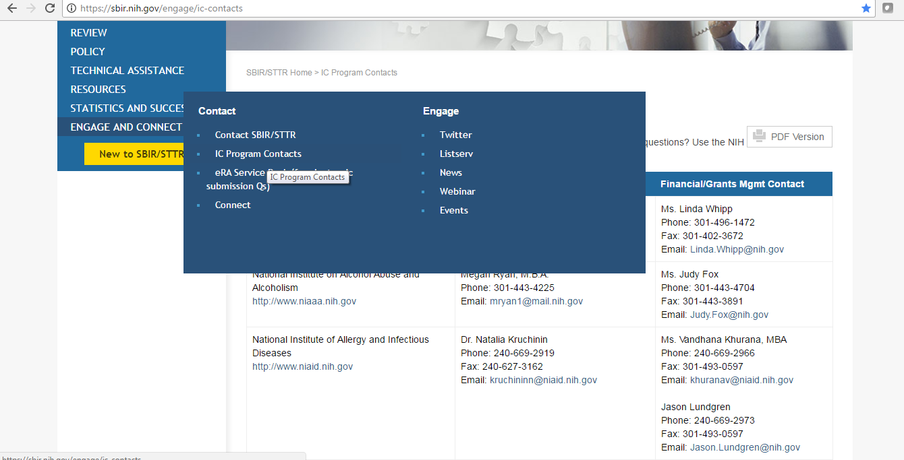
Super Important Piece of Advice
Talk to a HHS Program Officer at least a month before a deadline for application specific advice.

Slide 14
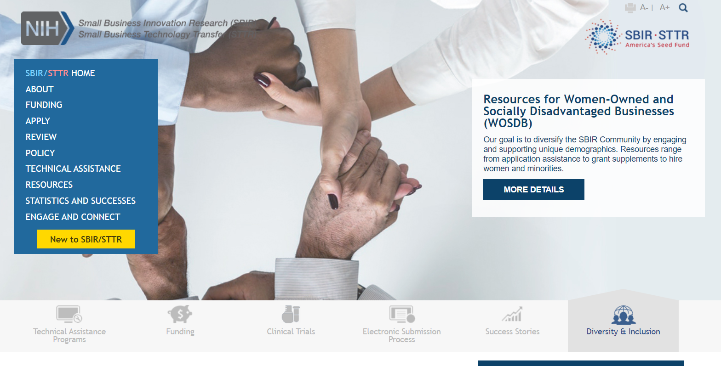
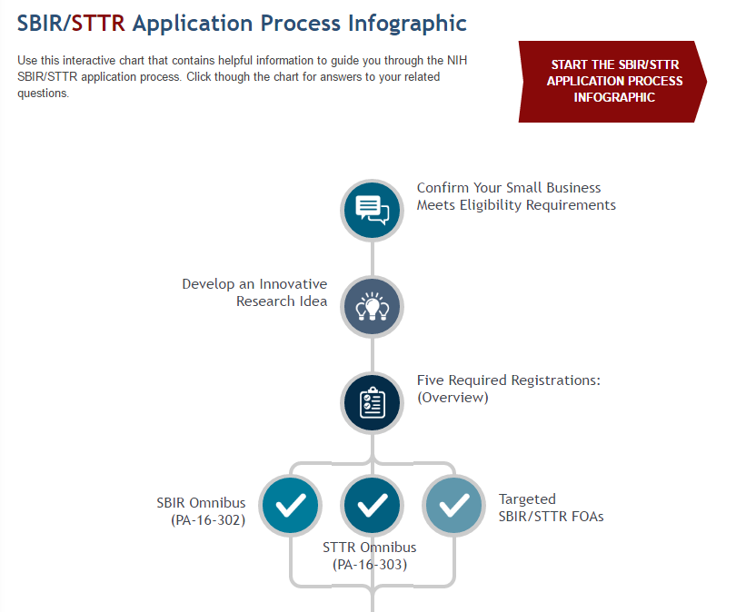
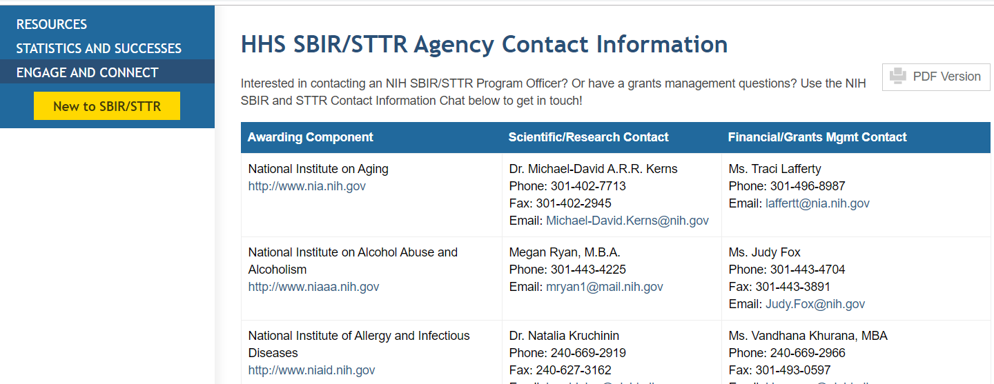
NIH SBIR/STTR Website
https://sbir.nih.gov

Slide 15
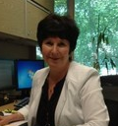
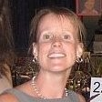
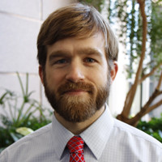
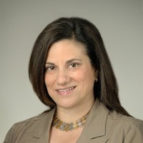
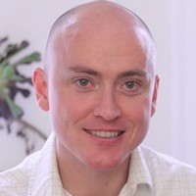
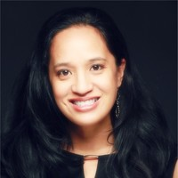
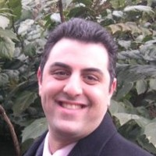
Application Resources
Small Business Program Managers
SF424 Application Guide
  How to apply for SBIR STTR from NIH
Annotated Form Set
  What to put into each form field
NIAID Sample Applications
  These projects got funded
NHLBI Small Biz Hangouts
  Research Plan tips
  Commercialization Plan tips
  Understanding Peer Review
  Managing Your Award

Slide 16
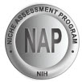

NIH Technical Assistance Programs
Niche Assessment Program-Foresight S&T
(Phase I Awardees)
Commercialization Accelerator Program - Larta, Inc.
(Phase II Awardees)
Helps jump start commercialization efforts
Determines competitive advantages
Develops market entry strategy
Technical Assistance/Training in:
  Strategic/business planning
  FDA requirements
  Technology evaluation
  Manufacturing issues
  Patent and licensing issues
Helps build strategic alliances
Facilitates investor partnerships
Individualized mentoring/consulting

Slide 17
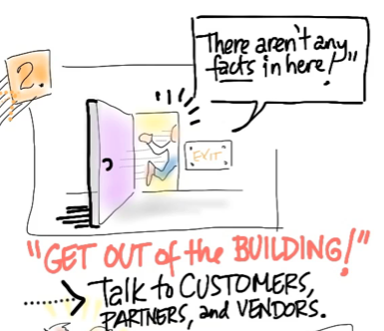
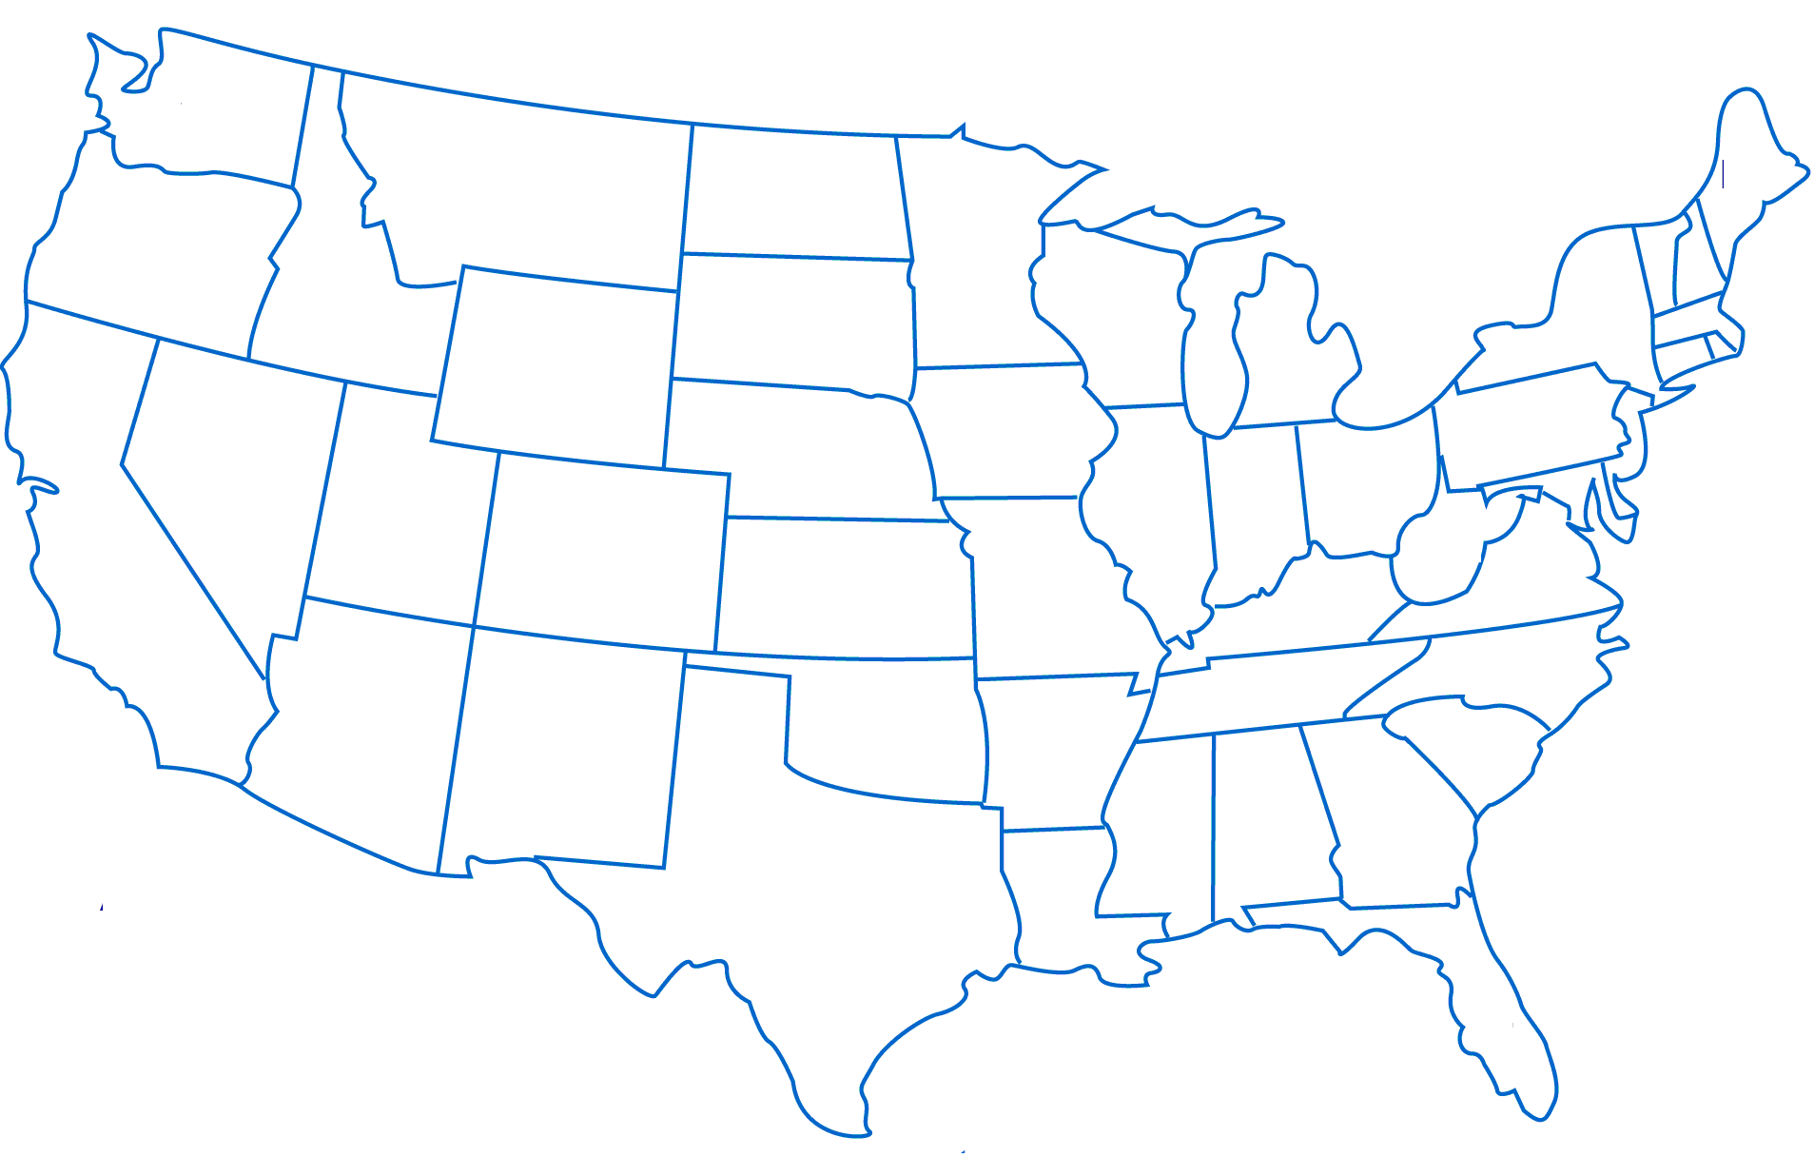





Technology Development Programs
(open to eligible awardees from participating ICs)
I-CorpsTM at NIH
Concept to Clinic Commercializing Innovation c3i program
Entrepreneurial
Immersion
6 Participating ICs academic PIs and small businesses
12 Participating ICs + CDC
Facilitating Partnerships
Investor
Forum

Slide 18
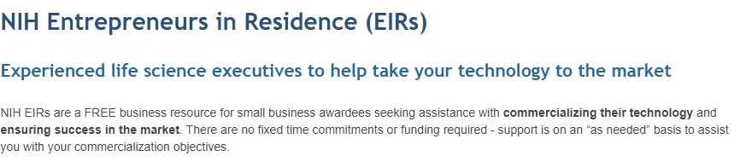
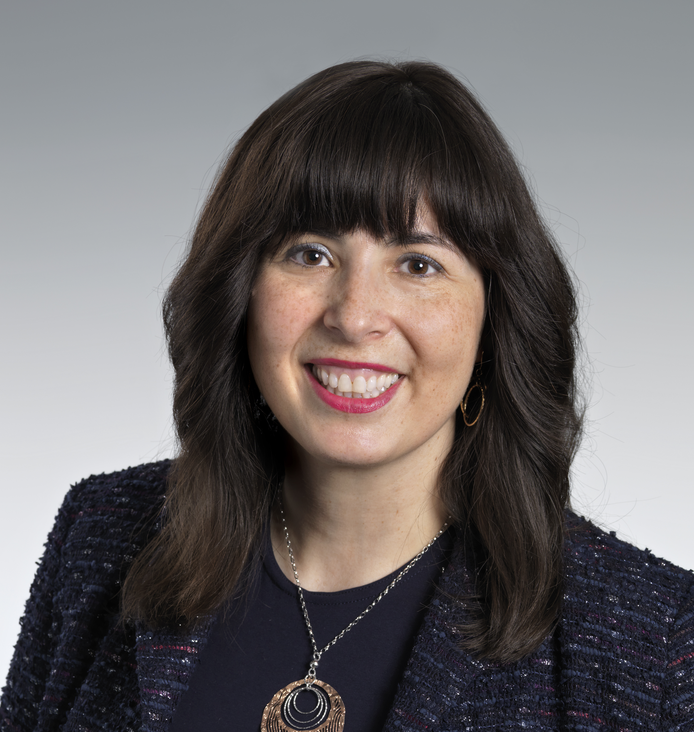

NIH Entrepreneurs in Residence
Ethel Rubin, PhD
John Sullivan, MBA
https://sbir.nih.gov/resources/entrepreneurs-in-residence/index.htm

Slide 19
Stay in the know!
Subscribe to the SBIR/STTR Listserv:
  Email LISTSERV@LIST.NIH.GOV with the following text in the message body: subscribe SBIR-STTR your name
NIH Guide for Grants and Contracts (weekly notification)
Follow us on Twitter: @NIHsbir

Slide 20

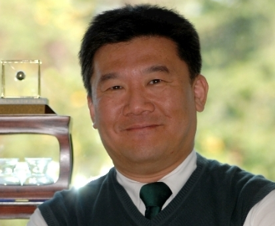


Ask us!
Robert Vinson
SBIR/STTR Program Manager
Phone: 301-435-2713
Email: vinsonr@mail.nih.gov
JP Kim, JD, MBA, MSc
SBIR/STTR Program Manager
Phone: 301-435-0189
Email: jpkim@nih.gov
sbir@od.nih.gov
Nita Basu, PhD
SBIR/STTR Program Manager
Phone: 301-451-7768
Email: dipanwita.basu@nih.gov
Bo Yeon Lee, PhD
SBIR/STTR Program Manager
Phone: 301-451-7784
Email: boyeon.lee@nih.gov

