Slide 1
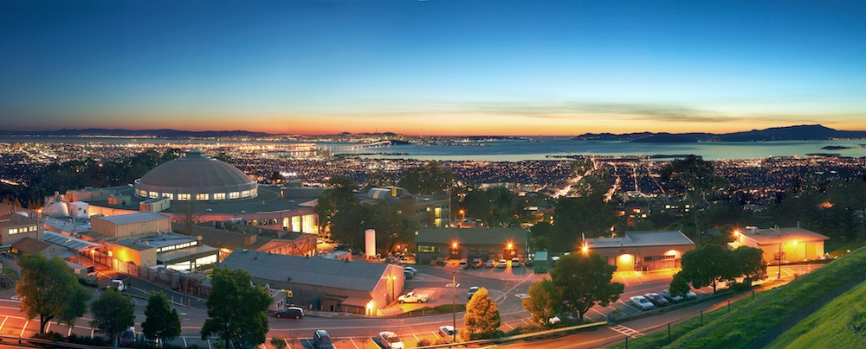

Intellectual Property Workshop
Marc T. Morley
October 15, 2019

Slide 2
Outline
Patent basics
Patent applications & prosecution
Patent strategy & searching
Investor considerations & due diligence
Working with your patent attorney

Slide 3
Constitutionally Granted Monopoly
Constitution – Article 1, Section 8, Clause 8:
  To promote the progress of science and useful arts, by securing for limited times to authors and inventors the exclusive right to their respective writings and discoveries.
US is unique in that the right is in the constitution. In other countries, it’s merely a statutory right.
This monopoly, or exclusivity, is what investors are paying for

Slide 4
But for a Limited Time
Patent term is for 20 years, starting from the earliest non-provisional priority date
  Used to be 17 years from issuance
Can be extended some due to delays at the patent office and/or FDA regulatory review
Upon expiration of the patent, the subject matter is in the public domain and free to be practiced by anyone (assuming there is no other patent encompassing the subject matter)

Slide 5
Importance of Patents
Competitive business advantage - “Speed bumps” & “Barriers”
Revenue stream from licensing
Access to others’ technology via cross-licenses
Leverage - Patents are a sword, not a shield
Demonstrate viability and value to investors
Ability to collect damages via litigation
Reasonable royalty / lost profits / hybrid approach
Enhanced Damages for willful infringement

Slide 6
Timeline: Get Ready to Practice Patience
Development and optimization of invention
Filing and prosecution of patent application
Maintenance
&
Enforcement
of patents
0
1
3-7+ years
21
Filing provisional patent application

Slide 7
OK, So… Did We Invent Something Or Not?
If in doubt, assume that you did
Exploratory questions:
  “What do we do that gives us a competitive advantage?”
  “How do we maintain this competitive advantage?”
  “What barriers to entry can we create for potential competitors?”
  “What would a competitor want to copy?”
  “What problems did we encounter and how did we solve them?”
Look at the “core” technology, “interfaces” to the core technology, ancillary aspects, consumables, and the like

Slide 8
Now what?
Don’t tell anyone outside your organization → no papers, no presentations, no disclosure
  Doing so could forfeit protection in foreign jurisdictions, and trigger a 1-year clock for filing in the US
  Disclosure under a Non-Disclosure Agreement is okay; but better to
  file a patent application first
Contact your tech transfer office/legal department/patent attorney

Slide 9
What’s the Patent Attorney Going to Want?
A sentence or two summarizing the advantages of the invention, the problems overcome relative to prior technologies, failures etc.
A detailed write-up of the procedures practiced to generate the invention
  Something along the lines of an experimental section from a paper
Data & figures → needs to demonstrate that the you can do what you’re claiming, and hopefully includes comparative data showing improvements in comparison to the state-of-the-art
Any presentation or draft manuscript describing the invention

Slide 10
Is the Discovery/Improvement Patentable?
Any new and useful process, machine, manufacture, or composition of matter, or any new and useful improvement thereof (35 USC 101)
  Not a composition as found in nature; not a natural process
What kinds of things can I patent or are potentially eligible for patenting?
  Processes/Methods (methods of use, methods of making, methods of dosing …)
  Machines
  Manufacture
  Compositions of matter (small molecules, nucleic acids, polypeptides, cells, antibodies, intermediates …)
  Improvements

Slide 11
Is the Discovery/Improvement Patentable?
Must be novel (35 USC 102) → all claimed elements are not found in a single pub, in the precise claimed combination or orientation
  A device with elements ABDC is novel over a device ABCD having the same elements, but arranged differently
Must be non-obvious (35 USC 103) → claimed elements not found in pub combo and/or has a surprising advantage over the prior art
  ABDC device likely needs to show surprising advantage over ABCD device

Slide 12
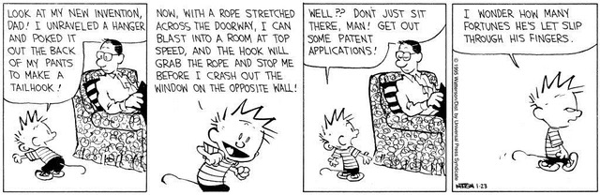
When to File

Slide 13
When to File
US is a first-to-file jurisdiction, as are all foreign jurisdictions, so it’s a race to the patent office
But you need data to support the application and ensure a right to the provisional filing date, so best to obtain data before filing
Consider whether to file prior to meetings with investors or collaborators irrespective of data
File prior to publications, seminars or any public disclosure!

Slide 14
Inventorship
An inventor is someone who contributes to the conception of the invention
This is different from authorship, as someone who performs experiments (reduces the invention to practice) is not necessarily an inventor
  Experimenters can be inventors if they encounter a problem that they solve, and without which the invention could not have been reduced to practice
Inventorship is a claim-by-claim determination
An inventor has an undivided interest in the invention, even when there are multiple inventors
Important to make an effort to get this right as a patent with the incorrect inventorship is invalid

Slide 15
Inventorship Scenarios
Adam conceives of an idea for a new solar cell stack. Adam asks Ben to make the solar cell stack. Ben does so without encountering any problems. A patent application is filed listing Adam as the sole inventor.
Same scenario, but Ben encounters a problem using the literature procedure that he solves without consulting Adam. The invention could not have been made without Ben solving this problem. A patent application is filed listing both Adam and Ben as inventors.

Slide 16
Inventorship Scenarios II
Carl and David are both Ph.D. scientists working for different companies but have been trying to find ways to collaborate. Carl has a new material for a solar cell, and they are trying to determine how best to incorporate the material into the solar cell to maximize efficiency. After several weeks of discussion, Carl and David have not solved the problem. Another week passes, and David, alone, has an insight that solves the problem. David wants to file a patent application without listing Carl as an inventor. A patent application is filed listing both Carl and David as inventors.

Slide 17
Inventorship Scenarios III
Chemist discovers a new chemical compound that kills leukemia cells. Chemist approaches Professor at University to test the compound on Professor’s lymphoma cell line suspecting it likely is effective against it. Professor confirms that the compound works very well against the cell line and shares the optimal lethal dose with Chemist. Professor tells Chemist “I did not discover anything here, you own it.” Who owns the invention of treating lymphoma with the compound?
  Chemist
  Professor
  University
  All of the above
  Chemist and University

Slide 18
Inventorship Scenarios IV
An artificial intelligence device discovers a new design for a container for more efficient storing of multiple containers?

Slide 19
Patent Applications

Slide 20
Timeline of Process: 3 Key Filings
Enter Foreign Countries
(& US) from PCT
File PCT, US & Direct Countries (TW)
Maintenance
&
Enforcement
of patents
File provisional application
Patent Issues
0
1
2.5 years
3-7+
21

Slide 21
Types of Applications: Provisional
Typically the first application filed
Not prosecuted; merely a placeholder as it expires after 1 year
Does not trigger the 20-year patent term clock
No requirements on content since it is not prosecuted, so it can be filed quickly and inexpensively, a “thin” provisional
But, you get what you pay for, and risk losing your priority date if a thin provisional is filed, particularly in Europe

Slide 22
Thin Provisional Scenario
Applications claiming priority to “thin” provisionals risk losing their priority date because of weak support, allowing an intervening publication to become prior art and negatively impact the patentability of the claims.
Enter Foreign Countries
(& US) from PCT
(“National Phase”)
File PCT, US & Direct Countries (TW)
Maintenance
&
Enforcement
of patents
File provisional application
Patent Issues
0
1
2.5 years
(30 Months)
3-7
21
Intervening publication

Slide 23
Applications: PCT
Another placeholder application; preserves the right to file in most foreign jurisdictions and the US Delays prosecution for another 18 months
Must be a complete application (claims, specification, examples, figures, etc.)
  Oftentimes simply updating a well-written provisional application with new data
  Filing fees of ~$5k
Triggers the 20-year patent term clock
  Since no application is being prosecuted to a patent, using the PCT route results in a loss of 18 months of patent term because the start of prosecution is delayed 18 months, thus delaying issuance of a patent
  But this is a reasonable trade-off for many technologies and start-ups since substantive prosecution costs are also delayed

Slide 24
Applications: Non-PCT Countries
Taiwan, Argentina, and a few others
Not members of WIPO, so patent applications must be filed directly in each of those jurisdictions simultaneously with the PCT application
  Translation costs in most of these jurisdictions

Slide 25
Applications: National Phase
Deadline is 30 months from the earliest priority date (typically the US provisional filing date)
  Some countries provide an extra month, and are referred to as 31-month countries (i.e., Europe)
Registration of the PCT application in those jurisdictions where a patent is sought
  Typical jurisdictions: US, Europe, China, Japan, Canada, Australia
Can be a big cost item depending on the size of the application and the number of jurisdictions: $25k to $100k+
  These are filing & translation fees; little substantive attorney time is required at this stage

Slide 26

Where to File
Market size → where are the paying customers
Manufacturing center →
patents in markets
without customers
can prevent
infringing products
from being produced
Transportation centers (Hong Kong, Singapore) → makes
life difficult for a competitor to bring
the infringing
product to market if
they can’t ship the
product through these centers

Slide 27
Applications: US Non-Provisional
Filed from the PCT application, or directly from the US provisional application in parallel with a PCT application
  Can also be filed direct as the first application
  Filing triggers the 20-year patent term clock, if not already triggered by the PCT applications
Undergoes substantive prosecution
Can seek expedited review

Slide 28
Applications: Flavors of US Applications
Non-provisional: can be a first filed application, filed as a first-filed application, from a provisional, or via the PCT application
Continuation: filed from an existing US non-provisional application to pursue claims of similar subject matter
Divisional: filed from an existing US non-provisional application to pursue additional claims the PTO says are separately patentable
Continuation-in-part: filed from an existing US non-provisional application, where new examples and/or figures are added to the specification

Slide 29
Patent Family Tree
Provisional Application
A, B, C, D
PCT
Application
A, B, C, D, E
U.S. Patent –
Claims to A
EP Patent
CA Patent
CN Patent
JP Patent
AU Patent
KR Patent
BR Patent
Pending U.S. Non-
Provisional Application –
Claims to E
U.S. Patent –
Claims to B
U.S. Patent –
Claims to C

Slide 30
Preparation & Filing Cost
Provisional: $10-15k+, depending on the scope and strength of the application
US Non-provisional: $1k in filing fees
  May involve some attorney fees as well if there is new data, or depending on the condition of the provisional application that was filed
PCT: $5k in filing fees
  May involve some attorney fees as well if there is new data, or depending on the condition of the provisional application that was filed
Direct filed jurisdictions: Often include translations

Slide 31
Preparation & Filing Cost II
National Phase filing: $25k to $100k+
  These are filing fees; no substantial attorney time is required at this stage
  US is about $2k; Europe is about $10k; translations required in China, Japan, Korea ($$$)
  $50k could include US, Australia, Europe, Canada, China, & Japan (depending on the size of the application)
US Continuation, divisional, continuation-in-part: $1k in filing fees; $0-3k in attorney time for new claims

Slide 32
Patent Prosecution
(examination/review of the application)

Slide 33
US Formalities
For US application, the attorney will ask for your signatures on an assignment, a declaration, and a power of attorney
The assignment assigns your rights in the invention to your employer
  Should be obtained for any provisional, PCT application and US non-provisional application not filed from a PCT application
The declaration is an acknowledgement by the inventor to the USPTO that the inventor is the original inventor, has read and understands the application, and that all information provided to the USPTO is material to patentability
  Signed under penalty of perjury
The power of attorney grants the attorney the right to act on your behalf to prosecute the patent application
  A separate power of attorney is needed for each jurisdiction

Slide 34
Foreign Formalities
Assignment required in many foreign jurisdictions → but can use the assignment obtained for the PCT application
But, many smaller jurisdictions in Asian, South American & Middle East require “legalization”, a process of sending the documents to an embassy or consulate in the US to review and approve the documents
A separate power of attorney is needed for each jurisdiction

Slide 35
Timeline of Process: Prosecution
Enter Foreign Countries
(& US) from PCT
File PCT, US & Direct Countries (TW)
Maintenance
&
Enforcement
of patents
File provisional application
Patent Issues
0
1
2.5 years
3-7+
21

Slide 36
Timeline of US Prosecution
Restriction Requirement
(2-month initial deadline; extendible by 5 months)
Non-Final Office Action
(3-month initial deadline; extendible by 3 months)
FINAL
Office Action
(3-month initial deadline; extendible by 3 months)
National Phase
Patent Issues
Allowance
2.5
5-6
3-7
Response to Restriction Requirement
Response to Non-Final Office Action
Response to
Final Office Action

Slide 37
Is My Invention Patentable?
Must meet statutory category of subject matter (35 USC 101 – machine, composition of matter, methods, etc.)
Must be novel (35 USC 102) → Has anyone else done the exact same thing?
Must be non-obvious (35 USC 103) → Is my innovation inventive enough?
Quid Pro Quo (35 USC 112) → Have I put the public in possession of the invention in adequate detail and taught how to make and use the technology?

Slide 38
Prosecution Vocabulary
Restriction Requirement: where the PTO considers the claims to cover at least 2 inventions, the PTO asks the Applicant to pick one invention to be searched and examined because only one invention can be searched and examined
  Unelected inventions can be pursued in one or more divisional applications
Species election: oftentimes a secondary request in a Restriction Requirement for the Applicant to pick a single example the PTO will use as a starting point for the search
  This does not restrict the claims, unless the exact combination of elements selected is found in the examiner’s search

Slide 39
Prosecution Vocabulary
Non-Final Office Action: following an initial review of the patent application and a search, the PTO rejects the claims as not patentable
Response/Amendment: Applicant’s response to the Office Action that includes claim amendments and remarks to the rejections
Final Office Action: a second office action
  Final in name only, as you can continue prosecution by paying a fee (Request for Continued Examination) to rescind the finality of the Final Office Action

Slide 40
US Duty of Disclosure
USPTO has a duty of disclosure that applies to the patent attorney, the inventors, and anyone else involved with filing and prosecuting the patent application
The duty requires disclosure to the USPTO of documents and references that may be relevant to the patentability of the invention
  This disclosure is called an Information Disclosure Statement (IDS)
The duty is satisfied by providing the patent attorney with relevant references you are aware of
  Does not need to include all references you are aware of, or duplicative references that include the same or similar description provided by another reference already cited

Slide 41
Foreign Prosecution
Prosecution begins 1-5 years after entry, and only after a Request for Examination is filed and a fee is paid → another delay mechanism for the applicant to consider whether the application should be examined or abandoned
  Also a fee-generating opportunity for the foreign patent office
Prosecution then proceeds with one or more office actions
Deadlines may be extendible, depending on the jurisdiction
Some jurisdictions operate by setting an Acceptance deadline from the first office action → a deadline by which time the application must be placed in condition for allowance, typically 1-year
  Must be more timely in responding and more proactive with claim amendments

Slide 42
Strategy & Searching

Slide 43
IP Strategy
Filing strategy
Defensive filings
Accelerated filings
International filings
Trade secret v. patents
Other Forms of IP: Trade Secrets, Design patents, Plant Patents, Plant Varieties & trademarks

Slide 44
Design the IP to Maximize Value
For patents: pursue multiple patents and multiple types of claims to best protect the technology and its improvements
  Product/Composition of Matter claims
  Method of using claims
  Method of making
Cover your product and its improvements
Cover improvements on your competitors' products (leverage)
Later filings provide the opportunity to obtain protection in additional foreign jurisdictions especially where earlier filings were filed more conservatively

Slide 45
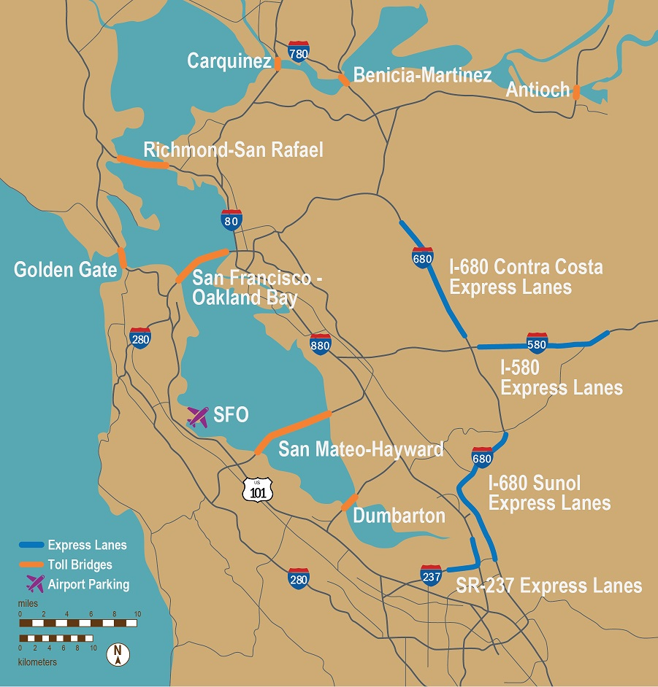
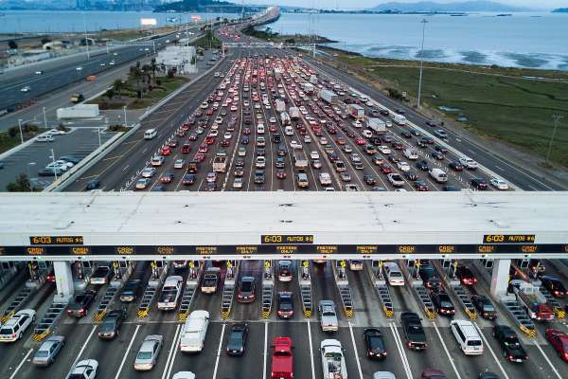
Design the IP to Maximize Value

Slide 46

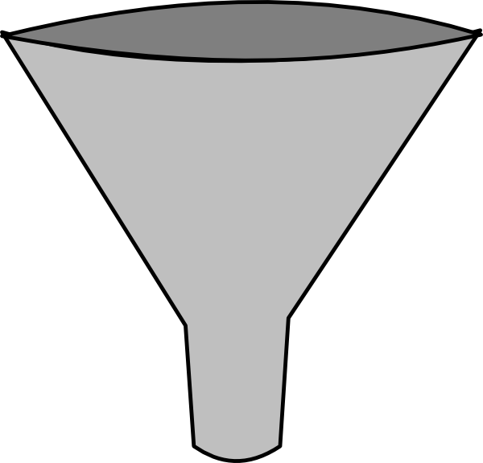
Prioritizing Filings from Lots of Ideas
Cover the contemplated commercial product
Cover a competitor’s product
Consider deprioritizing methods of making/screening
Does the filing create value?

Slide 47
More on Maximizing Value
Revisit the patent strategy at least once a year
Has the contemplated commercial product changed, or are there new aspects?
Do the existing patent filings continue to provide protection? If not, are the existing filings worth maintaining?

Slide 48
IP Strategy: Accelerated Applications
Consider where an issued patent would help with fund raising or for enforcement
US non-provisional as the first application
  Accelerates by 1-year the start of the 20-year patent term, but potentially enables enforcement that much sooner
Track One: application receives priority attention at the USPTO, with the goal of issuing a patent within 1-year of filing
  Filing fee is about 2-3x the regular fee
  No extensions of time are available
  Best to pursue narrowed claims focused on a commercial embodiment
“Special Status” → Certain circumstances can qualify for accelerated or “special” examination (applicant health, age, certain technologies)
Alternative → simply pursue focused claims from the beginning, and respond quickly

Slide 49
IP Strategy: International Filings
Costly endeavor
  Translation costs to enter
  Parallel prosecution costs in multiple jurisdictions
  Annual fees in each jurisdiction just to maintain application in good standing
  Multiple fee-generating opportunities (Request for Examination)
Trade-off is patent protection in more markets leading to greater value
File broadly only for cornerstone technologies

Slide 50
Enforcement: A Right to Exclude
35 USC 271(a): Except as otherwise provided in this title, whoever without authority makes, uses, offers to sell, or sells any patented invention, within the United States or imports into the United States any patented invention during the term of the patent therefor, infringes the patent.
There is no right to practice your own invention

Slide 51

What is a Trade Secret?
Information that is valuable because it’s secret
  Owner must make reasonable efforts to maintain secrecy (e.g., NDAs)
  Protection lost if becomes public (unlike patent protection)
Examples:
  Formulas (e.g., for Coke)
  Manufacturing methods
  Software programs
  Business plans
  Customer lists
  Pricing information
Enforcement
  Misappropriation
  Damages, injunction
Notes:
Created by state law

Slide 52
Trade Secret or Patent Protection?
Advantages of Trade Secrets
No set expiration
No examination costs (aside from maintaining confidentiality)
No need to show patentability (novel/non-obvious/eligible)
Disadvantages of Trade Secrets
Do not protect your invention if
  Reverse engineered
  Independently invented
  Accidentally becomes public
Difficult to enforce and license
  Must prove technology obtained by improper means (e.g., violation of NDA, breaking and entering)
Only patents provide exclusive rights to an invention

Slide 53
IP Strategy: Trade Secret v. Patent
One or the other → there’s no getting both, and no changing your mind later
When filing a patent application, you are required to disclose, but not identify, the “best mode”, i.e., the best way of practicing the invention or the most preferred embodiment
Trade secret enables you to keep that best mode secret
Nearly always more advantageous to obtain patent protection (which most inventors recognize)

Slide 54
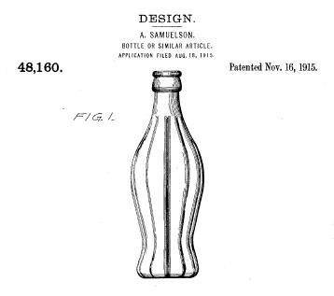
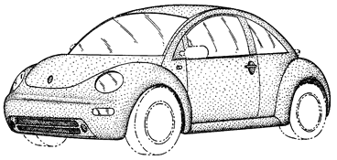
Design Patents
Protect article's unique design/appearance
  Cannot be functional
Examples: Ornamental designs of jewelry, furniture, beverage containers
Examination by USPTO
  Easy application
  Must be novel, non-obvious
14 year term

Slide 55
Trademark Protection
Trademark Rights
Right to prevent others from using confusingly similar marks
Must be the first to use mark on the particular goods/services in order to have the rights
Types of Protection
Common law (use-based) = limited geographically
State registration
Federal registration = nationwide priority rights

Slide 56
Freedom to Operate

Slide 57
FTO Searching
What? → a search to identify issued patents with claims that appear to cover one or more aspects of a contemplated product
Why? → can then design around to avoid paying a license fee
  Investors want to see freedom-to-operate
When? → when specific marketed product identified, but may need to accelerate if investors are asking, or you’re in a competitive area with a lot of patents
Cost? → $5-15k+ depending on scope, technology and number of patents resulting from search

Slide 58
Establishing Freedom-to-Operate
Expired patent → If a patent is identified as creating an FTO issue, but expires before your contemplated product launch, then not a barrier
  The subject matter of an expired patent is in the public domain and free to be practiced by anyone → assuming there isn’t another continuation/divisional on file
Innovate! → developing your own innovations and IP allows you to move away from dominating patents
License → not ideal, but sometimes obtaining a license at a reasonable cost can be worthwhile

Slide 59
Landscape Searching
A search to identify what the patent landscape looks like in a particular space
  Also useful to keep track of competitors
Useful when considering entering a busy space as it helps identify areas to avoid, such as those that would create a FTO issue, and possibly areas that are less crowded
Costly because the search terms are typically broad, and involves very open-ended searching
Best to consider when closer to market entry

Slide 60
FTO v. Patentability/Validity
FTO does not mean you are entitled to a patent
  FTO ≠ novelty of your claims
  FTO ≠ non-obviousness of your claims
Granting of a patent does not mean you have FTO
  Granted patent ≠ others don’t have a patent that can block you
  Generic patent claims v. narrow/specific claims

Slide 61
Preparing Your IP for Investors

Slide 62
Preparing Your IP for Investors
Investors: "Will the IP help us win this bet?"
Investors seek to assess the extent to which a company’s IP and its IP strategy will support the goals and objectives of the company
  Helps investors confirm that a company is worth an investment and that it justifies the magnitude of the planned investment

Slide 63
Make the IP Attract Attention
Develop an IP Strategy and link it to the Company Goals
Any company worth an investment is always established with well-defined goals and objectives
  These goals and objectives drive the conduct of the business and guide most decisions
  The goals and objectives should inform the IP strategy as well (and hopefully there is one)
Company Goals
Company IP

Slide 64
Investor Due Diligence
The scope of a due diligence will depend on the size of the investment. For significant investments any potential investor will want a great deal of information and documentation.
Among the information that will be requested is:
The company’s products and intended products
The strategy the company pursuing to protect its IP
The key competitors
The proposed markets
The IP portfolio – an itemized list of all patents and pending applications
The key prior art in the field and how it affects patentability
The relevant third party patents / pending applications
Any potential barriers to FTO
Any agreements the company has with employees and outside consultants
Any technology licensed granted to the company

Slide 65
Investor/Acquisition Due Diligence
Inventorship, ownership and other rights to the technology
Scope of Protection & Enforceability
Patentability and Validity
Freedom-to-Operate

Slide 66
Investors: Ownership
Does the person, entity, company own the IP? Alone?
Were the correct inventors listed on the patent?
Have all inventors assigned rights?
Any Inventorship disputes?
Do the employment agreements include language assigning rights to the company, and not just a promise to assign?
  What about for any consultants?
Make sure the assignments refer to the registered company name
And that you obtain assignments for each provisional application, as well as the first US non-provisional and any PCT application

Slide 67
Investors: Agreements
Any issues with past employment agreements of key employees?
Relevant license agreements?
  Exclusivity for any licensed IP?
  Any onerous terms?
Are non-employee consultants obligated to assign to the company?

Slide 68
Investors: Scope of Protection & Enforceability
How broad (or narrow) is the protection provided by the claims? Will it cover the technology and design-arounds?
  You’re looking for enforceable scope, not just broad scope
  Broad claims may appear to cover more ground, but are more susceptible to attack when enforced
How about coverage for actual or potential competitor products?
Are there multiple layers of protection with later and later expiration dates?
Is the geographic coverage acceptable?

Slide 69
Investors: Patentability (pending applications)
Will patents be granted?
What do the search reports look like?
Is there a clear patentability story to overcome prior art? → this starts with the initial drafting of the patent application
If there are known challenges, is there data to help overcome the issues?

Slide 70
Investors: Validity (granted patents)
Conduct validity search looking for prior art
Are the granted claims novel and non-obvious?
Was all prior art known to inventors and those associated with the prosecution of the application submitted to the patent office?

Slide 71
Investors: Freedom-to-Operate
Has a FTO search been conducted, and what are the results?
  Many times these searches have not been conducted
A blocking patent is not a deal killer
  Can you obtain a license?
  Perhaps the claims are overly broad and there’s a reasonable invalidity position that can be established

Slide 72
Investor Attorney Performs Due Diligence
Investor patent counsel will provide report to investor:
  Identifying material issues and weaknesses with any of the DD investigation areas
  (Possibly) recommends alternative strategies
Report is weighted heavily by investors and used to set valuation
Important to have good patent counsel answering questions from investor patent counsel

Slide 73
What Can You Do to Prepare
Do your own due diligence, such as an internal audit – and do it as early as possible
  Help uncover any issues well in advance of the actual due diligence
  Company will be able to anticipate the hard questions likely to be raised by the investor team and provide answers that (hopefully) are able to demonstrate that significant issues do not exist
  Company demonstrates to its potential investors a high level of sophistication and a commitment to “get it right”
Steps can be taken to remedy any IP deficiencies and to mitigate any risk

Slide 74
Defending the Due Diligence
Anticipate and be able to address the "difficult" issues
Rely on legal counsel and use the results of the internal audit
Use an internal point person to coordinate the due diligence and communicate with the investor team
  Through this person, articulate the company’s business strategy, its goals, and its IP strategy
TIP: Package all information – spreadsheets listing all IP, lists of prior art and third party patents – so that it is readily available to investor counsel
  Investor team will appreciate readily available copies of patents and applications, prosecution histories, and company agreements

Slide 75
Working with Your Patent Attorney

Slide 76
Working with Your Patent Attorney
Communication: Your patent attorney should understand your level of sophistication and tailor communications accordingly
If you receive correspondence you don’t understand, ask questions; you need to understand the attorney’s motivations to provide the necessary information
Keep the patent attorney informed of what you’re doing; no one likes surprises
  Your patent attorney can help you avoid issues when they know what’s going on

Slide 77
Working with Your Patent Attorney
Deadlines: The patent process is driven by deadlines, so pay attention to them and give your attorney as much information as possible as far in advance as possible
  Your patent attorney should also be providing reminders far enough in advance

Slide 78
Working with Your Patent Attorney
Cost: Your patent attorney bills by the hour, so give them what they need without substantial delay → the more time your attorney spends sending reminders, the bigger your bill, but without the value
Ask for a budget for each project so you know what you’re paying for
  It’s okay if the budget changes, as sometimes the target changes, but it’s good to have a starting point to keep everyone focused
Annual patent budgets can grow rather quickly after about year 3, so ask your patent attorney for an estimated patent budget for the year
  There will be several assumptions baked into the patent budget, but it will help you to budget and plan, reducing surprises

Slide 79
Working with Your Patent Attorney
Example budget e-mail for initial patent portfolio:
  This is an example of a 15 month budget where a “quick and dirty” provisional is originally filed. Estimate costs at $17k-34k, which is broken down as follows:
  1 U.S. Provisional Application $2-4k
  (“quick and dirty”/coversheet)
  Convert to Non-provisional: $6-15k (cost to complete the provisional)
  1 PCT Application: $6-10k
  Strategy counseling: $3-5k

Slide 80
Working with Your Patent Attorney
Example budget e-mail for small patent portfolio:
  This is the second year of filing applications without any substantive prosecution, so I estimate costs at $21k-31k, which is broken down as follows:
  1 PCT conversion: $6-10k
  1 new application: $12-16k
  Strategy counseling: $3-5k

Slide 81
Working with Your Patent Attorney
Example budget e-mail for a medium-size, growing patent portfolio:
  This is the second year of substantive prosecution for these cases, so I estimate costs at $82k-95k, which is broken down as follows:
  13 Annuity fees at $1k: $13k
  7 Prosecution actions at $6k: $42k
  2 exam requests at $2k: $4k
  1 PCT conversion: $6-10k
  1 new application: $12-16k
  Strategy counseling: $5-10k

Slide 82
Marc T. Morley
MTMorley@mintz.com
858-314-1563

