Slide 1
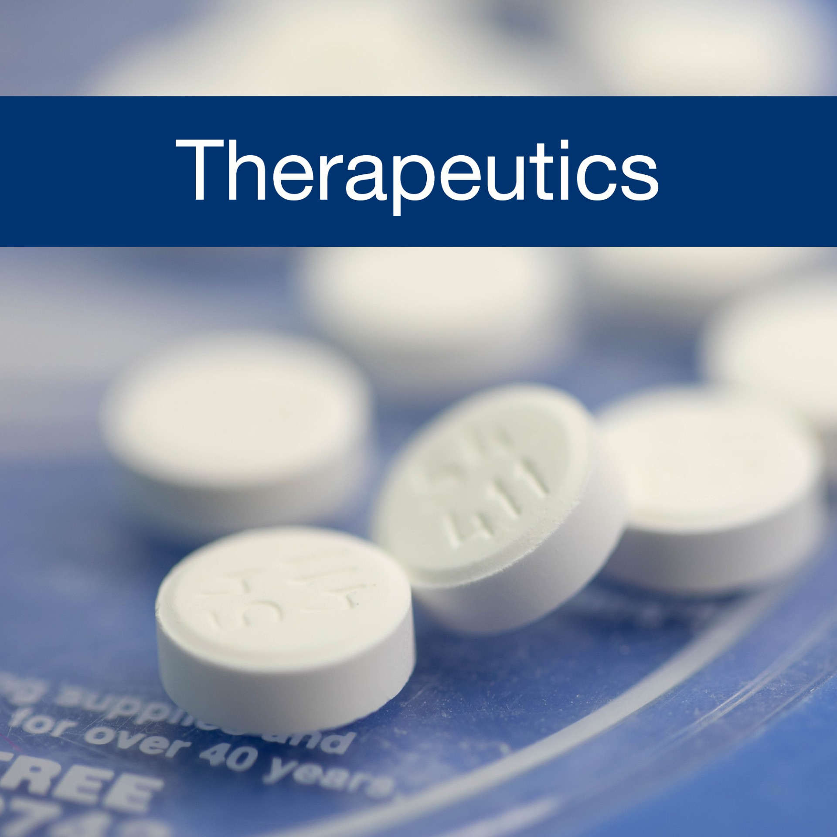


Slide 2
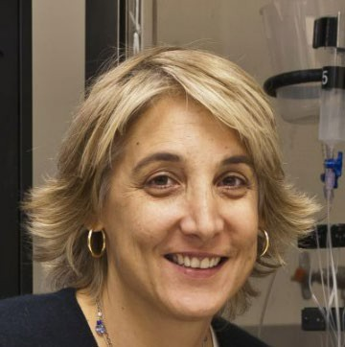
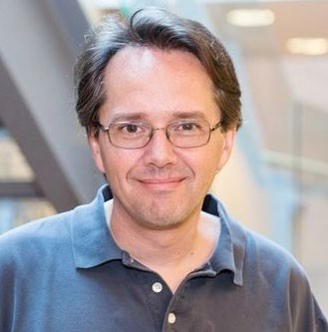
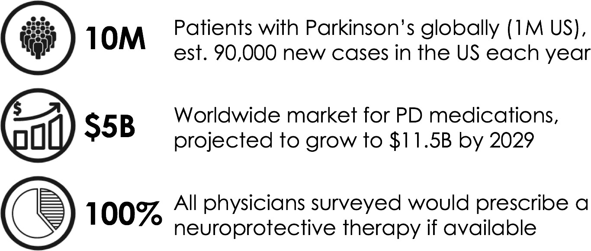
NURR1 receptor modulators for the treatment of Parkinson’s disease
153 Therapeutics
DISEASE/INDICATION: Parkinson’s disease (PD)
UNMET NEED:
Current PD therapeutics are symptom-modifying only and lose efficacy with disease progression
Novel therapeutics that treat PD symptoms and slow disease progression will be game-changers in the therapeutic landscape
Pamela England, PhD
Co-founder, 153 Therapeutics
UCSF Professor, Pharmaceutical Chemistry
Matthew Jacobson, PhD
Co-founder, 153 Therapeutics
UCSF Professor, Pharmaceutical Chemistry
PRODUCT: Small molecule therapy that modulates Nurr1 function
Lead compounds activate Nurr1 with desired transcriptional activity for treating PD symptoms & neuroprotection
Lead compounds readily cross BBB (brain/plasma ratio >1)
Strong efficacy in animal model with statistically significant improvements in motor deficits, dopamine levels and reduction in neuroinflammatory markers
COMPETITIVE ADVANTAGE:
Potential for dual mechanism of action (symptom management + neuroprotection)
DATA/TRACTION:
Strong results in alpha-synuclein disease model study
Good progress with optimized leads through early non-GLP tox
IP filed for composition of matter; patents granted in JP and AU
© 2026 The Regents of the University of California
Notes:
cleared

Slide 3
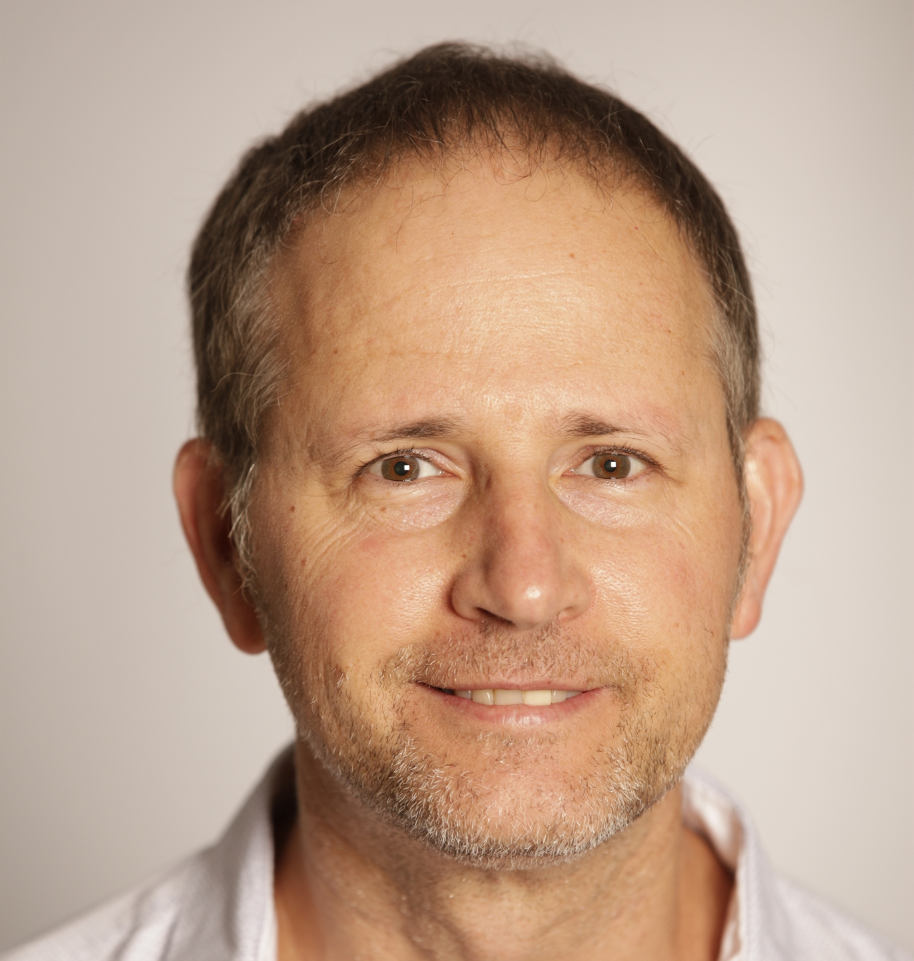
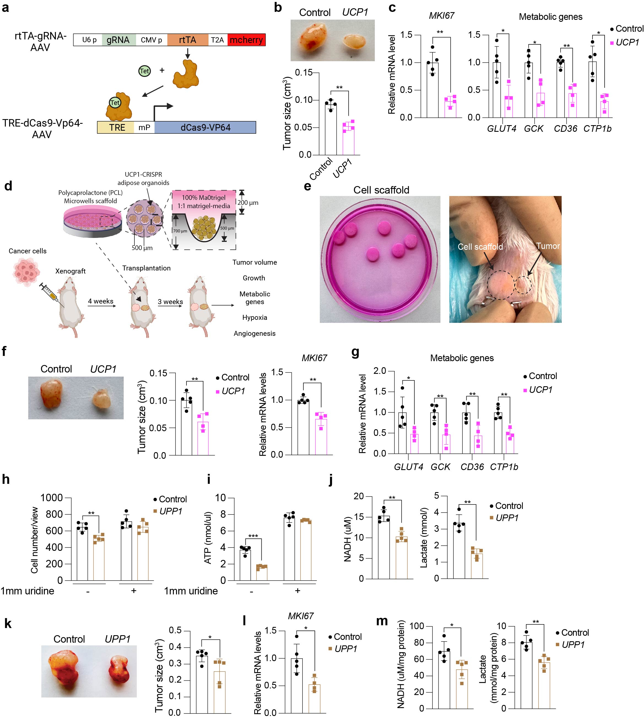
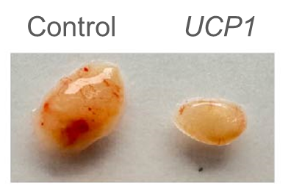
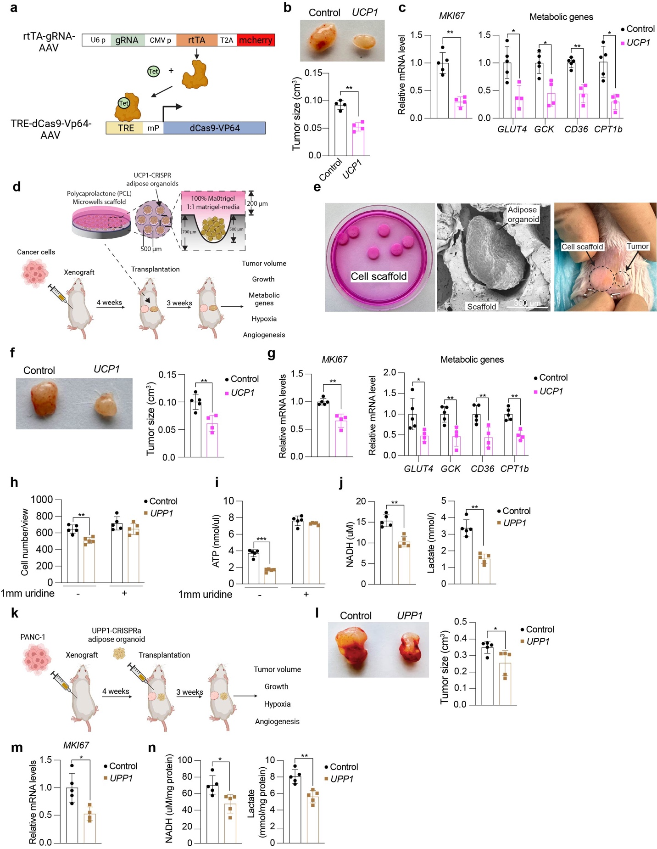
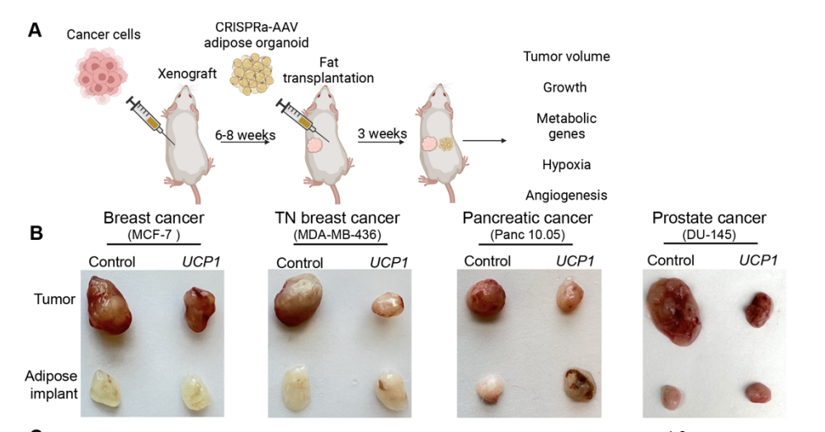
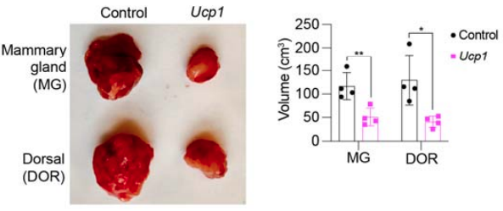
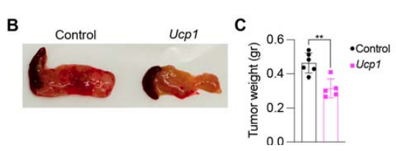
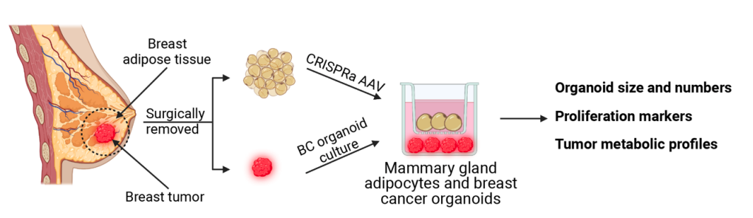
Adipose Manipulation Transplantation, A Novel Cancer Therapy
Nadav Ahituv, PhD
Professor, Bioengineering
& Therapeutic Sciences
DISEASE/INDICATION: Pancreatic ductal adenocarcinoma, breast cancer, and a variety of other cancer types.
UNMET NEED: The current cancer metabolism drug candidates, targeting glucose and fat metabolism, failed to display efficacy in suppressing tumor growth in clinical trials.
PRODUCT: First-in-class adipocyte-derived therapies targeting cancer metabolism, engineered adipocyte payloads through ex vivo “browning” of white adipose tissue (WAT) and transplantation to suppress tumor progression.
COMPETITIVE ADVANTAGE:
Adipocytes have a lower immune response, allowing more straightforward development of “off-the-shelf” adipocytes.
Can be customized for different cancer-associated metabolic programs, but it can also be used in obesity, metabolic disease, diabetes, and aging-related symptoms.
DATA: in vivo POC: Engineered adipocytes suppress tumor growth in multiple cancer models (xenograft, mouse genetic models, patient-derived).
AMT therapy can be administered in an inducible manner
Adipose organoids engineered to overexpress UCP1 co-cultured with cancer cells suppress tumor growth in xenograft mice
Engineered adipose organoids suppress tumor growth in pancreatic and breast cancer genetic mouse models
Patient-engineered adipocytes from dissected breast cancer tumors suppress cancer growth

Slide 4

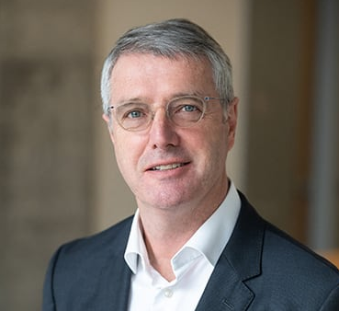
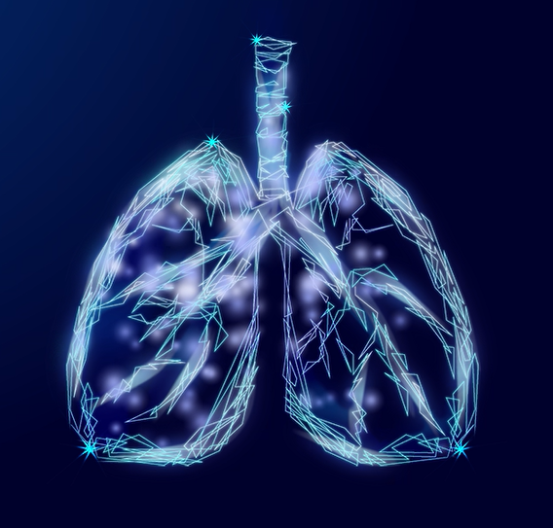

Targeting Mucus Plugs to Improve Lung Health
SOLUTION:
Fexlamose is a novel
inhaled best-in-class therapeutic
candidate designed to improve
lung health by liquifying mucus plugs.
Fexlamose is a thiol-modified
carbohydrate (“thiol-saccharide”)
which cleaves mucine disulfide
bridges to liquefy (“lyse”) mucus plugs.
John Fahy, MD, MS
Founder
Endowed Chair in Pulmonary Medicine, UCSF
PROBLEM:
Between 30% and 50% of COPD patients with severe and very severe COPD suffer from airway obstruction caused by mucus plugs.
Mucus plugs reduce lung function and diminish quality of life.
There are no drugs approved to effectively liquify mucus plugs (mucolytics) in patients with COPD.
FUNDING:
>$18M in NIH funding; $41M Series A (Canaan, Orbimed, Hatteras, Pappas, UCSF Foundation Investment Company )
PROGRESS
• Phase 1 studies in healthy volunteers completed
• Phase 2 POC started in q4 2024
• Top line efficacy data expected in q3 2026
LEARN MORE​:
© 2026 The Regents of the University of California

Slide 5

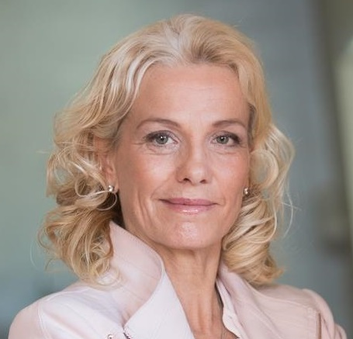

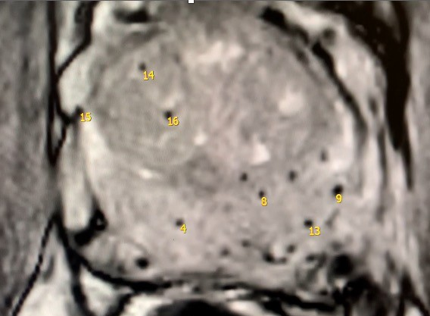
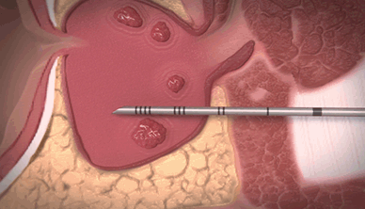
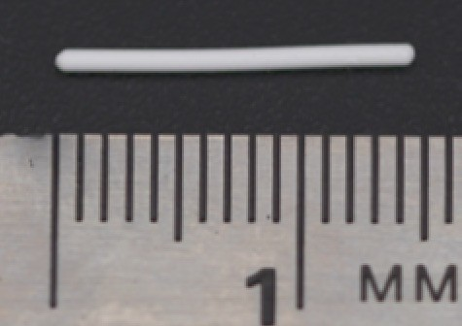

We drive innovation in oncology and solid organ diseases through development of organ selective therapy for early interception and treatment of the prostate disease
Pamela Munster, MD
Founder and CSO,
UCSF Professor of Medicine,
Director Early Phase Clinical Trials Unit
Pre-implant seed
Post-implantation seeds in
cancerous human prostate
5
SOLUTION:​
Implant and delivery systems for localized, sustained drug delivery without systemic side effects.
Focused on treatment of localized prostate cancer and BPH.
Robust pipeline of target specific organ selective strategies.
PROBLEM:
1 in 6 men will be afflicted with prostate cancer during their lifetimes, 30k will die every year.
12M men in the US seek treatment for benign prostate hyperplasia every year.
Current therapies mainly centered around systemic testosterone ablation.
TRACTION:
$37M in funding led by Cure Ventures, Mission BioCapital and Johnson & Johnson
Ongoing clinical trial with Enolen®️
LEARN MORE​:
© 2026 The Regents of the University of California

Slide 6
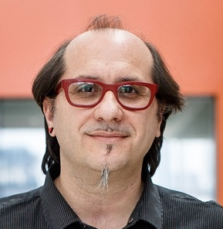
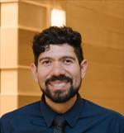
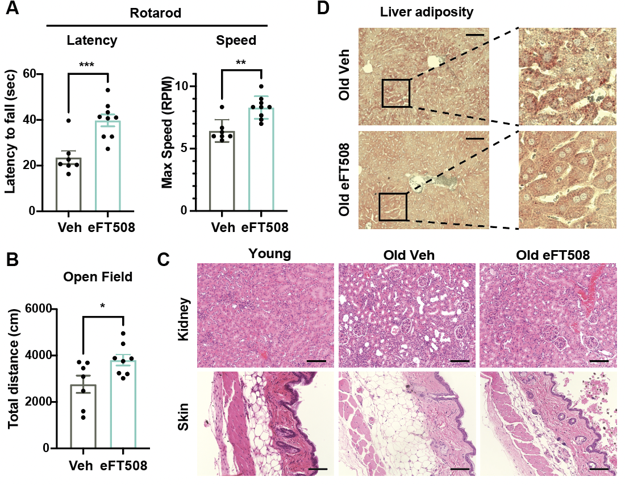
A novel therapeutically druggable target to reverse aging
DISEASE/INDICATION: Aging and Age-related diseases (i.e. Alzheimer’s disease, sarcopenia, and cancer)
UNMET NEED: The aging population is growing at a rapid rate, and consequently, there is an increase in chronic age-related diseases.
Saul Villeda, PhD
UCSF Associate Director,
Barkar Aging Research Institute
PRODUCT: Oral small-molecule therapy targeting a translation factor as an intervention for aging-related pathologies.
Davide Ruggero, PhD
Cellular & Molecular Pharmacology UCSF
Inhibitor
COMPETITIVE ADVANTAGE: In the context of aging, there are no current therapies targeting translation factors
A new selective translation factor as a therapeutically druggable pro-aging factor.
A novel therapeutic approach to reverse aging, prevent, and treat age-relative diseases.
Inhibitor
Inhibitor
Inhibitor
Young (3 months) and old mice (22 months) after 8-week’s treatment of inhibitor or vehicle control through oral gavage. The inhibitor improved motor ability (rotarod testing) (A), anxiety (open field) (B), reduced fat in epidermis and kidney and restored the collagen organization in skin (C), and decreased lipid accumulation in liver (D).
DATA: Restored fitness of hematopoietic stem cells and the hematopoietic system in mice. Reversed aging-associated pathological features and cognitive decline. Decreased inflammatory cytokine level, senescence, and senescence-associated secretory phenotype factors in plasma in mice.
Inhibitor

Slide 7
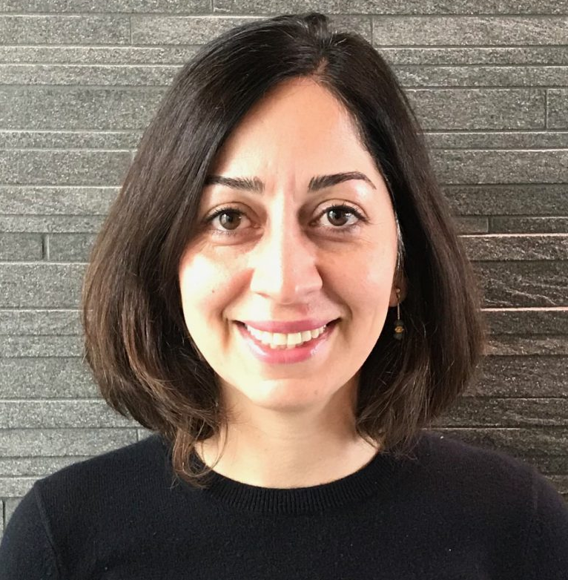
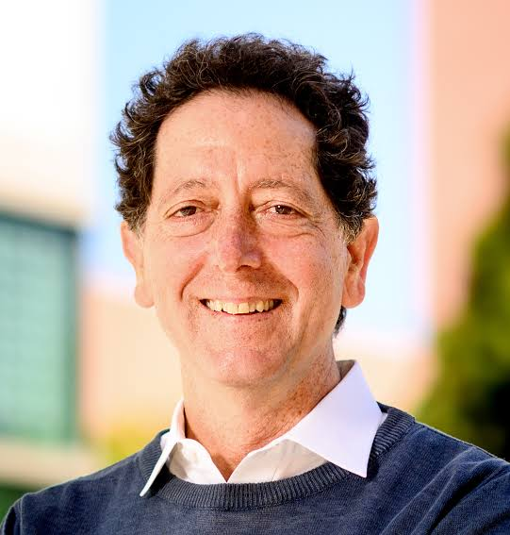
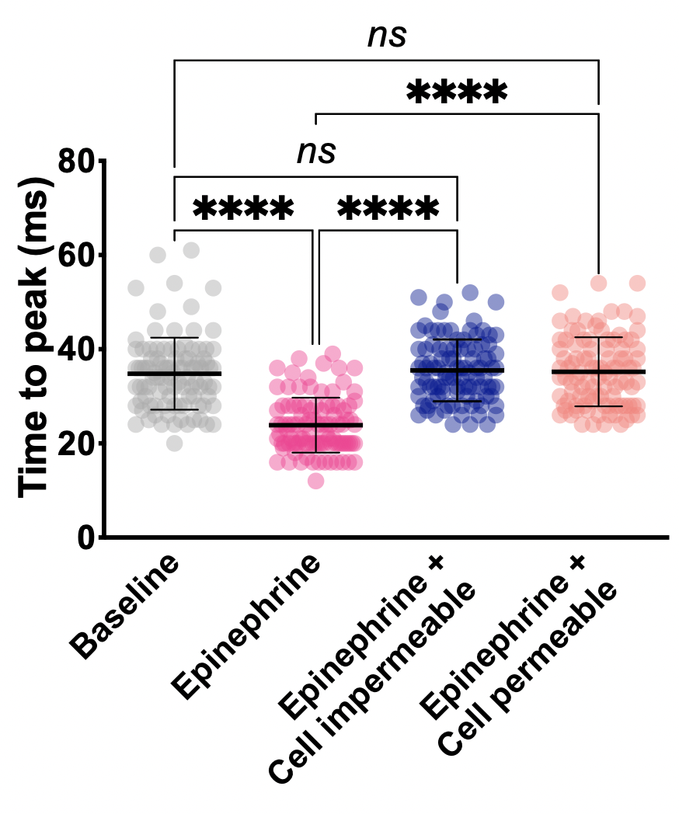
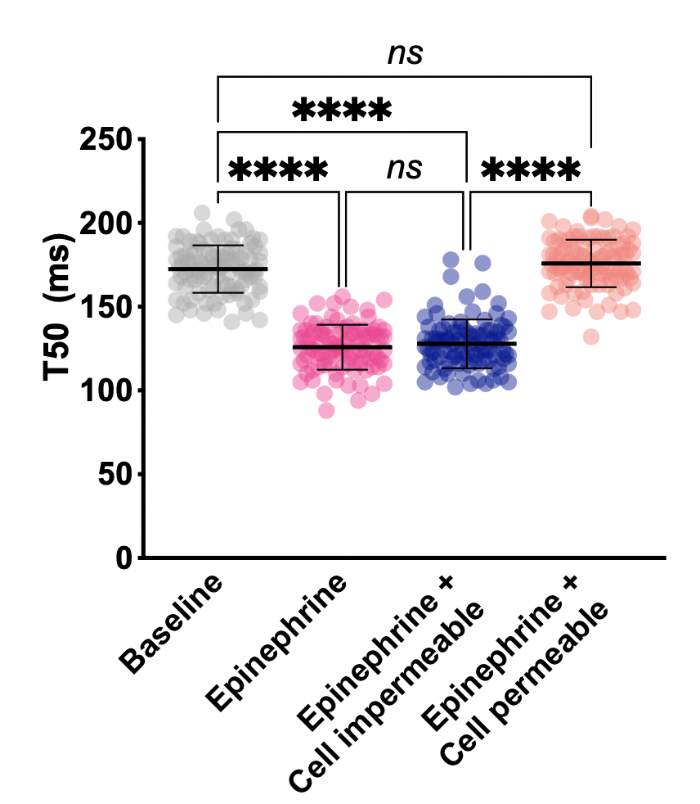
Cell Surface Restricted β1 Blocker for Diastolic Dysfunction
DISEASE/INDICATION: Heart Failure with Preserved Ejection Fraction (HFpEF) is a complex and challenging condition characterized by the heart’s inability to relax and fill properly during diastole, despite normal ejection fraction. Patients with HFpEF often experience debilitating symptoms such as shortness of breath, fatigue, and exercise intolerance.
UNMET NEED: Current therapies for HFpEF, including traditional β-blockers, fail to address the nuanced pathophysiology of the disease. While β-blockers reduce elevated heart rates and contractility, they also unintentionally suppress key relaxation mechanisms critical for diastolic function. This dual inhibition exacerbates the condition for many patients, leaving clinicians with limited effective treatment options. There is a clear need for innovative solutions that selectively target the pathological mechanisms of HFpEF without compromising diastolic relaxation.
PRODUCTS: A novel class of small molecule β-blockers that are designed to selectively inhibit plasma membrane β1-adrenergic receptors while sparing Golgi-localized β1ARs. By preserving the signaling pathways responsible for cardiomyocyte relaxation, these spatially restricted β-blockers offer an opportunity to address the unique challenges of HFpEF.
DATA: Early in vitro data demonstrate the potential of these compounds to reduce heart rate and contractility while maintaining diastolic function. With validation in relevant animal models pending, this invention represents a compelling opportunity to address a critical unmet need in heart failure therapeutics.
Roshanak Irannejad, PhD
Asc. Professor, Cardiovascular Research Institute, Department of Biochemistry & Biophysics
Kevan Shokat, PhD
Professor, Department of Cellular and Molecular Pharmacology
Contraction
Relaxation
A cell-impermeable antagonist only inhibits β1AR-mediated responses at the plasma membrane. Comprehensive analysis of Ca²⁺ transient trace in adult cardiomyocytes and comparison of time to peak (a readout of contraction) and time to decay (T50, a readout of relaxation) from the four groups. N = 100 cells per condition in n = 3 independent biological replicates.

Slide 8

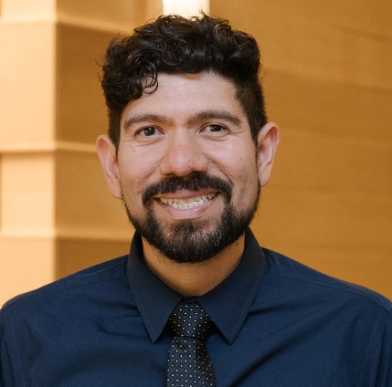
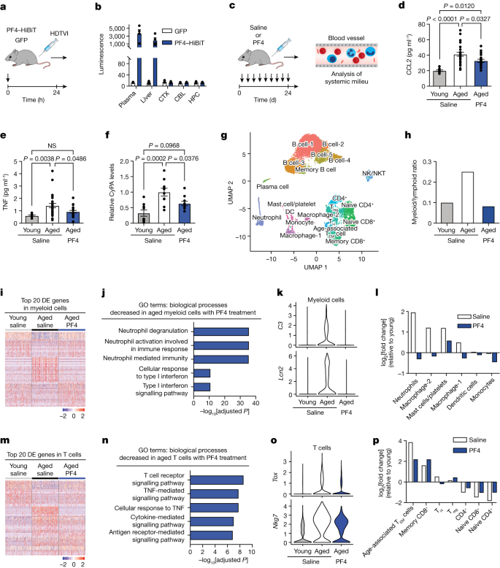
Development of Platelet-Derived Exercise Mimetics as a Treatment for Alzheimer's Disease and Related Dementias
DISEASE/INDICATION: Alzheimer's Disease (AD) and related dementias are progressive neurodegenerative diseases where the current standard of care is to address symptoms and not the underlying cause.
UNMET NEED: Current therapies are symptom-modifying only, have no effect on disease progression. New therapeutics are needed to address both AD symptoms and progression.
PRODUCT: Biologics that ameliorate disease. These can be administered peripherally and still have an effect disease.
COMPETITIVE ADVANTAGE:
Potential for dual approach (symptom management + neuroprotection)
DATA: This research has been published in Nature and Science. A novel composition of matter was generated for PF4 and an optimized screening assay is in place for GPLD1
Saul Villeda, PhD
Co-founder, Ceiba Bio
UCSF Associate Professor, Anatomy
Recombinant Pf4 (i.v.) every 3 days (q3day) in aged mice ( > 17 mo) reverses age associated inflammation (CCL2, TNF, CyPA) and lowers myeloid to lymphoid ratio

Slide 9

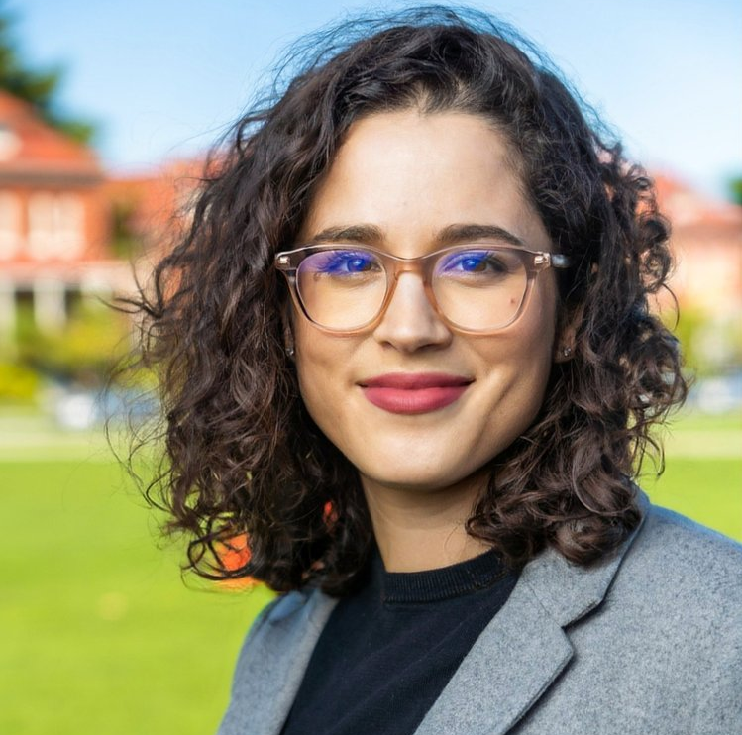
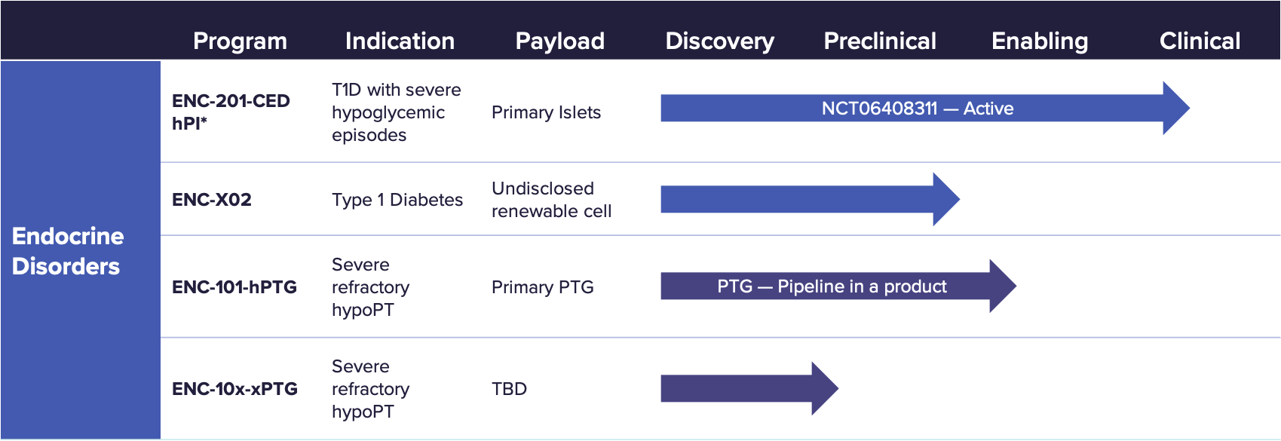




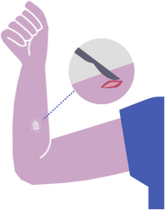

Redefining cell therapy for safe, scalable, immune-protected medicine.
Nutrient exchange and cell secretion
INSERT
UCSF
Founder/Co-Founder
Image
Crystal Nyitray, PhD
Founder and CEO
UCSF Alum
Blocks
immune
detection
Cell containment
ENCRT is approximately the size of a quarter and is implanted under the skin
SOLUTION:
Encapsulated Cell Replacement Therapy (EnCRT) platform supports cell needs and patient safety
Non-fibrotic biocompatibility for long-term function
Immune evasion without immune suppression
Scalable and modular for multiple cell types and diseases
TRACTION:
Positive interim results of its Phase 1 clinical trial of encapsulated islets in people with type 1 diabetes (T1D) in January 2026.
Encellin has been supported by Khosla Ventures, Endurance28, Box1, Pier70, HWI, YCombinator, American Diabetes Associate
LEARN MORE​:
© 2026 The Regents of the University of California

Slide 10
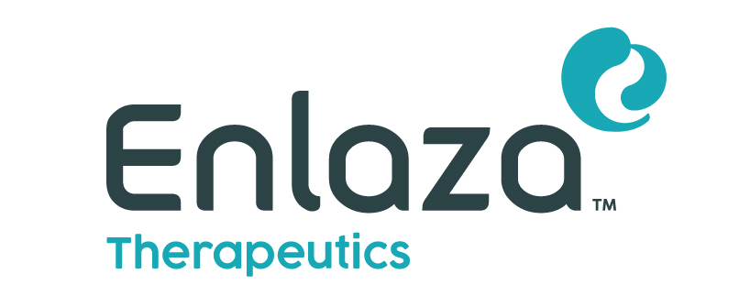
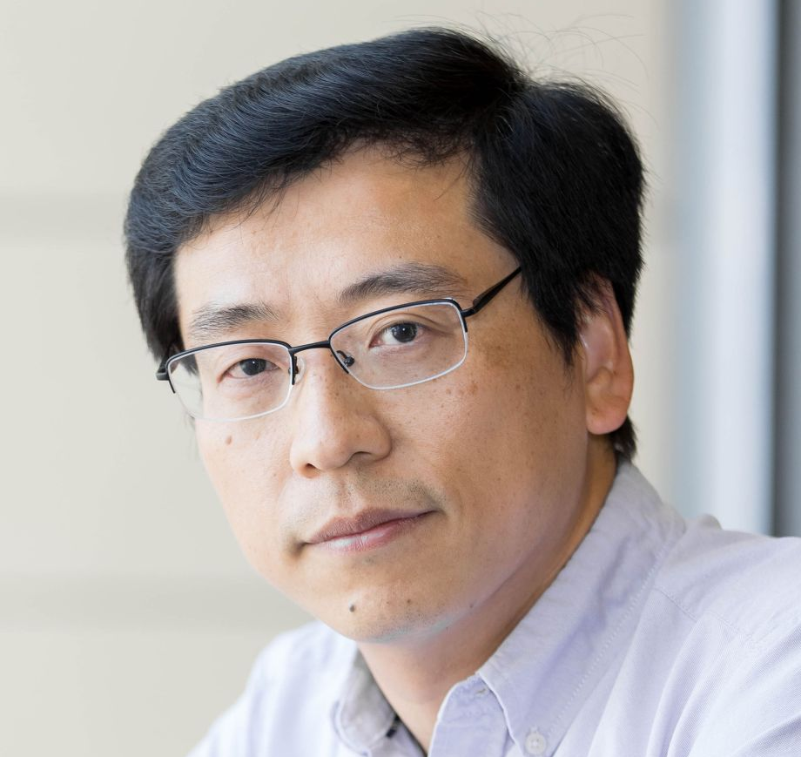

Pioneering Covalent Biologics
Lei Wang, PhD
Inventor,
Professor, Pharmaceutic Chemistry at UCSF
SOLUTION:
New generation of covalent ‘War-LockTM’ biologics
Proprietary unnatural amino acids.​
Protein drugs derived from the platform can be modified to incorporate various payloads, creating antibody-drug conjugates (ADCs) or radioligand therapies (RLTs) with specific target tissue delivery, without the need for half-life extension engineering.¹
PROBLEM:
Proteins bind target reversibly.
Most therapeutics still suffer from low tumor retention and high off-target toxicity.
TRACTION:
$100M in Series A lead by Life Sciences Group of J.P. Morgan Private Capital
2025 Collaboration with Vertex Pharmaceuticals
LEARN MORE​:
© 2025 The Regents of the University of California

Slide 11

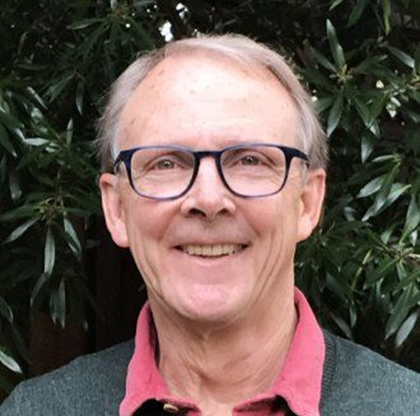
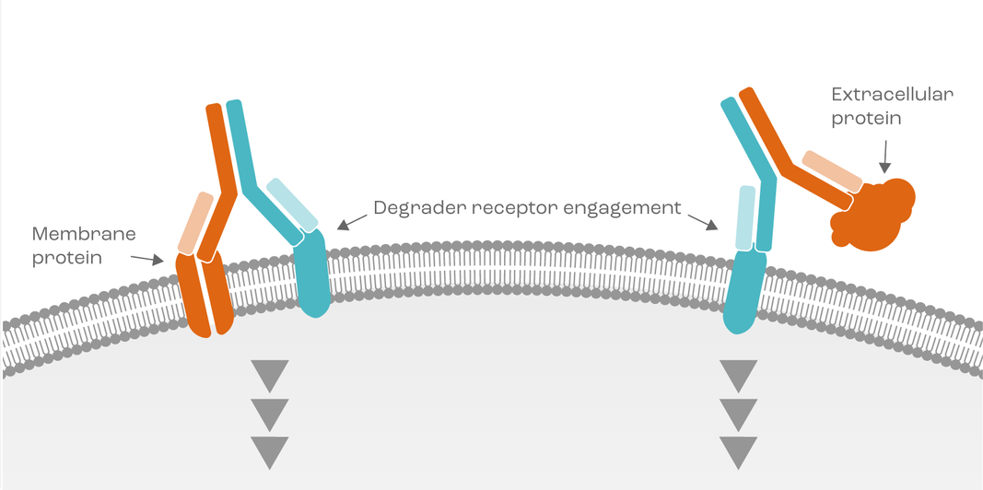
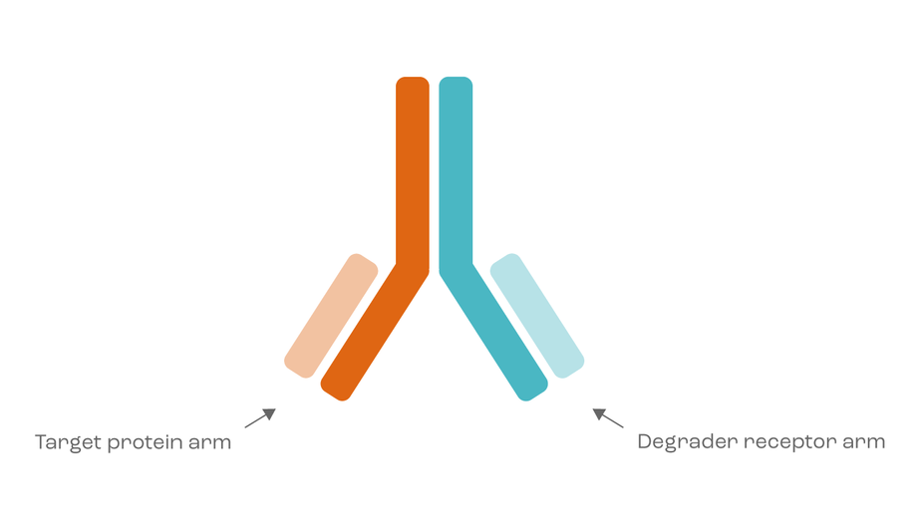
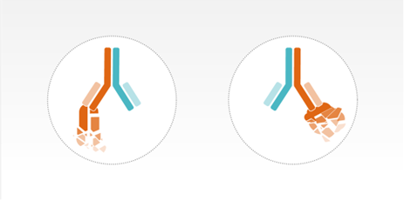

Expanding Protein Degradation to
Extracellular Membrane and Soluble Targets
INSERT
UCSF
Founder/Co-Founder
Image
Jim Wells, PhD
Co-Founder,
Founding Director, Small Molecule Discovery Center (SMDC)
Director, Antibiome Center
UCSF Innovator
SOLUTION:​
EpiTAC platform leverages bispecific antibodies and a novel atlas of tissue-selective degrader receptors to drive strong efficacy
Bispecific antibodies are scalable, manufacturable, and have good pharmacological properties that enable long half-life and durable responses.
PROBLEM:
1st generation protein degradation approaches target intracellular proteins only
40% of the proteome is unaccounted for
Need tissue-selective therapies that localize degradation to disease tissue, sparing healthy tissue and increasing the therapeutic index for strong durable efficacy and valuable combinations
TRACTION:
Demonstrated POC for soluble and membrane targets, including GPCRs
Raised $107M Series B in 2026 to advance multiple programs into the clinic
LEARN MORE​:
© 2026 The Regents of the University of California

Slide 12
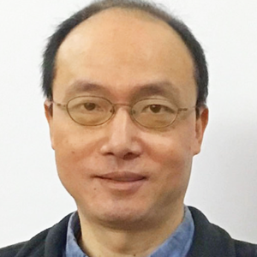
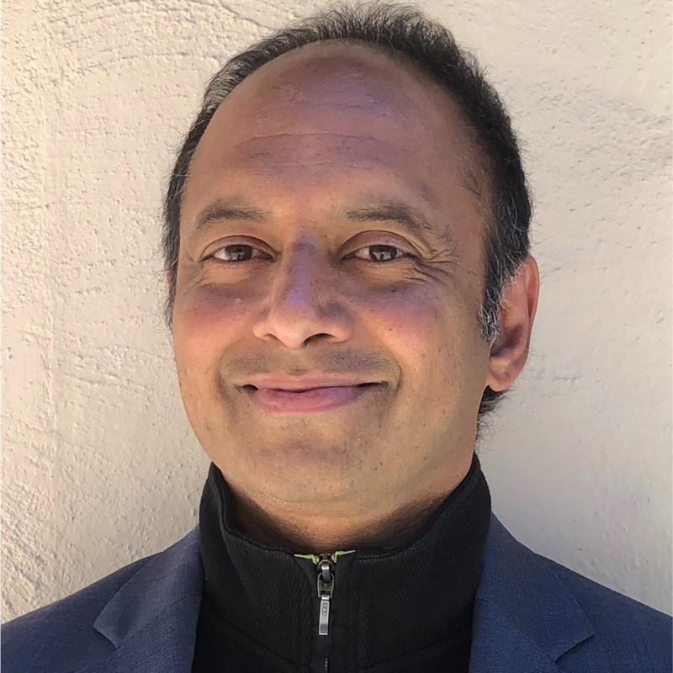
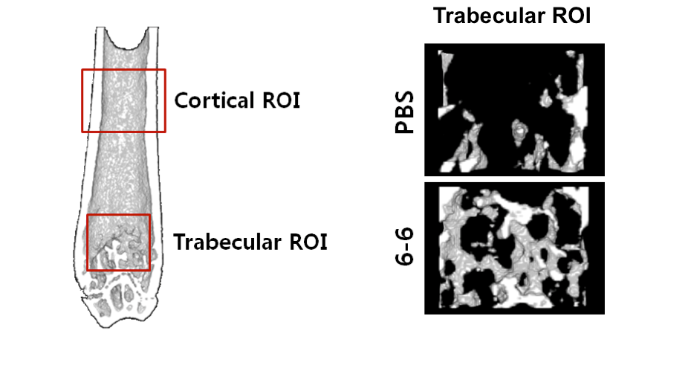
First-in-class Wnt Mab for Bone Building
DISEASE/INDICATION: Osteoporosis (TAM- $12B); Cancer bone metastasis (TAM- $5B); Osteogenesis imperfecta (TAM-$1B)
UNMET NEED:
- Lack of safe and effective bone building therapeutics
- Romosozumab builds bone but safety/efficacy limited to one year and can causes cardiotox
- Bisphosphonates, PTH, Denosumab do not build bone, cause side effects including jawbone degeneration, etc
PRODUCT: Wnt agonist Mab (“6-6”) binds to LRP5/6, a novel target with unique MOA to induce bone growth
COMPETITIVE ADVANTAGE: Builds bone, safe in rodent models, allosteric MOA, likely superior to Romosozumab
DATA: 30-80% improved bone growth compared to placebo in “gold-standard” in-vivo cancer-induced bone loss and osteoporosis models; head-to-head comparison with Romosozumab in progress
Bin Liu, PhD
UCSF Professor, Helen Diller Cancer Center
Ravi Srinivasan, PhD
UCSF XiR, Adviser
Multiple Myeloma mouse model: 80% increase in trabecular bone mass with 6-6 treatment compared with saline control

Slide 13
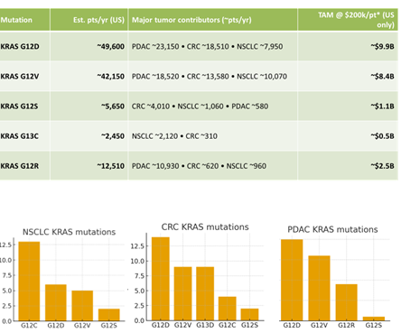
Kras Targeting Small Molecules
DISEASE/INDICATION: KRAS is considered to be the most common oncogenic gene driver in human cancers, including pancreatic cancer, non-small cell lung cancer and colorectal cancer. The mutations are associated with poor survival rates.
UNMET NEED: Despite its role as a driver oncogene, many KRAS mutations are considered undruggable (e.g. G12S, G12R, G13C). Current therapies face resistance within six months and pan-KRAS inhibitors lack selectivity and show modest clinical benefits.
PRODUCT: First-in-class, highly selective inhibitors for KRAS mutations G12S, G12R, G13C, and a dual on/off state inhibitor for KRAS G12D. These next generation drugs aim to overcome resistance and treat KRAS-driven tumors effectively.
COMPETITIVE ADVANTAGE: Dual ON/OFF inhibition avoids resistance and immune suppression seen in on-state-only drugs. Greater potency and selectivity compared to pan-KRAS drugs.
DATA: KRAS G12D: dual on/off inhibitors showed dose-dependent tumor regression in pancreatic cancer models. KRAS G12S: Beta-lactone inhibitors selectively suppress KRAS signaling and cancer cell growth with combination potential. Data on others as well.
Kevan Shokat, PhD
UCSF Professor, Pharmaceutical Chemistry
© 2026 The Regents of the University of California

Slide 14
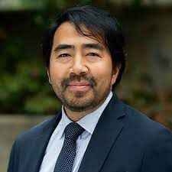
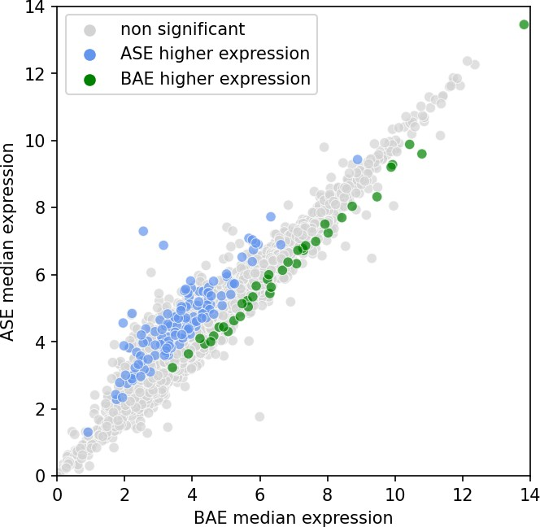
MAITRX
Allelic-informed target and drug discovery
DISEASE/INDICATION: Various cancers, prostate cancer being the initial focus and autoimmune diseases
Franklin Huang, MD, PhD
Associate Professor, Medicine and Urology
UNMET NEED: Many disease-causing genetic abnormalities, for example TERT promotor mutations, cause dysregulation and allele-specific expression is a marker of such dysregulation.
PRODUCT: In silico assay to screen and interrogate patient samples to identify allelically imbalanced genes when known genetic markers cannot be found. Machine-learning algorithms that incorporate clinical, genomic, and experimental data to identify allele-specific markers of unusual response, are used to predict drug response, and regulatory pathways that can be targeted
COMPETITIVE ADVANTAGE:
Integrates various inputs
Uses AI to train platform
Not limited to liquid biopsies
Can discover novel pathways
DATA: The screen has identified allele-specific events found in metastatic castration resistant prostate cancer not found in less aggressive prostate cancer
© 2026 The Regents of the University of California

Slide 15
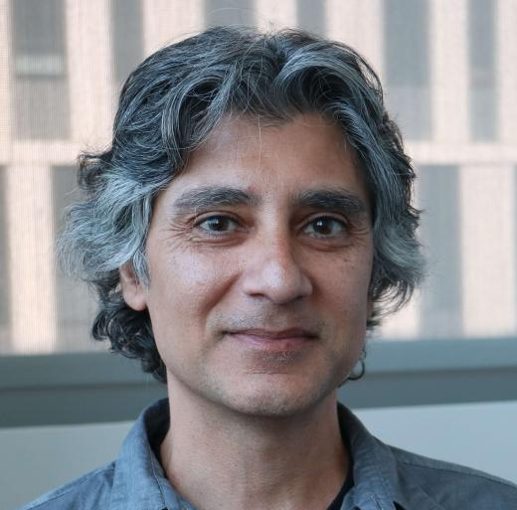
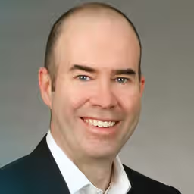
Novel Tyrosine Kinase Inhibitor for the treatment of T1D
DISEASE/INDICATION: T1D and other ER-stress-driven diseases
UNMET NEED: Currently, the only approved immunotherapy for T1D is teplizumab, a monoclonal antibody against CD3 expressed on T cells with modest efficacy, and not effective for new-onset T1D.
PRODUCT: A novel tyrosine kinase inhibitor, PAIR2, a partial antagonist of the unfolded protein response kinase/RNase. Use of PAIRs alone or in combination with immunotherapy, such as anti-CD3, to restore β-cell function and reverse diabetes.
Feroz Papa, MD, PhD Professor of Medicine at UCSF
Bradley Backs, PhD
Associate Professor of Medicine at UCSF
COMPETITIVE ADVANTAGE:
PAIRs partially antagonize IRE1α’s RNase, enabling precision control of ER stress and reducing the risk of impairing normal cell function.
PAIRs directly act on β cells to reduce ER-stress-driven apoptosis and preserve functional insulin-producing cells.
PAIRs work synergistically with immunotherapies that suppress autoimmune attack.
PAIRs have broad applicability across ER-stress-driven disease.
Weekly glucose levels with individual data points in newly diabetic NOD mice.
Diabetes reversal rates; diabetes defined as two consecutive readings >250 mg/dL, reversal as readings <250 mg/dL.
DATA: POC data in the mouse model with autoimmune-triggered type 1 diabetes.
© 2026 The Regents of the University of California
Notes:
SF2026-058
Lei Wan

Slide 16
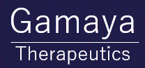
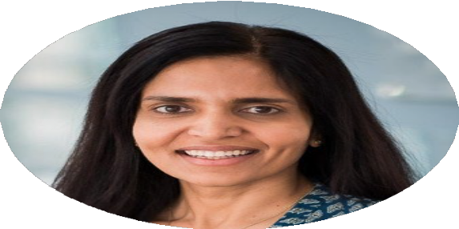
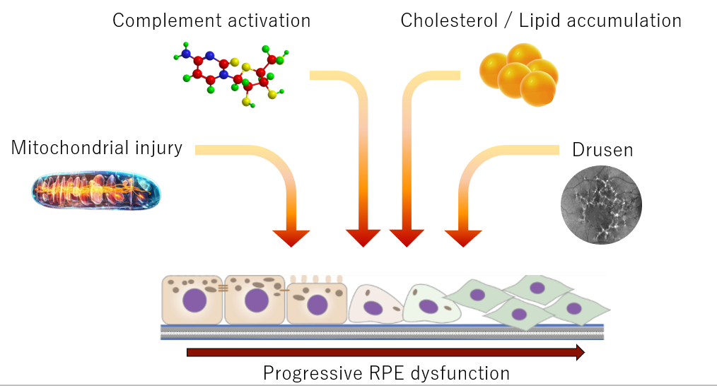
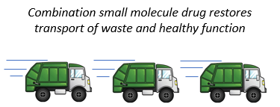
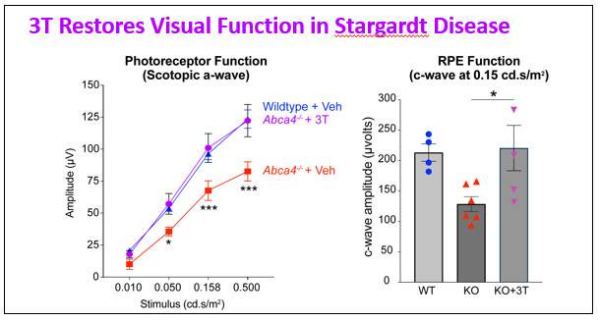
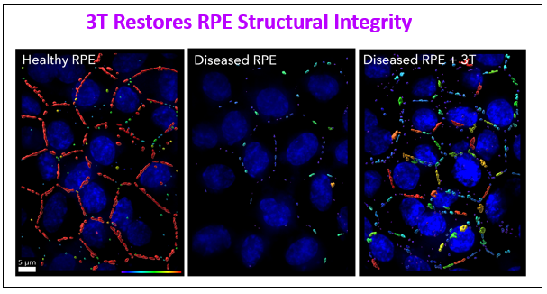
Multimodal Therapeutic for Dry-AMD and Stargardt
DISEASE/INDICATION: Dry AMD causes progressive irreversible vision loss in ~ 288 million people worldwide (2040) and represents a market opportunity of >$50B.
Aparna Lakkaraju, PhD
Professor, Ophthalmology UCSF Innovator
UNMET NEED: Recently approved treatments for dry AMD only slow the progression of vision loss. There are no approved therapies for Stargardt disease, which is the most common cause inherited macular degeneration. Volume of IVTs challenge clinical capacity
Patented combination therapy (NCE) addresses all known mechanism of RPE dysfunction
PRODUCT: Small molecule drug combinations that target multiple pathogenic nodes implicated in macular degenerations (RPE injury, complement activation, drusen deposition, metabolic stress, etc.). Administered systemically (vs intravitreal injection).
COMPETITIVE ADVANTAGE :
First novel small molecule drug that demonstrates restoration of visual function in preclinical models. Strong safety and retinal bioavailability profile for chronic diseases like dry AMD and Stargardt disease.
Pre-clinical Results:
DEVELOPMENT STAGE: Currently running IND enabling studies and raising $5M in seed funding to run FIH clinical trials. ~$10M non- dilutive funding has been invested up to this point.
Notes:
Put new content onto the template of the slide

Slide 17





Next Generation Fracture Healing
SOLUTION:
Injectable regenerative RNA therapeutic acerates fracture healing without surgery
Promotes healing through novel mechanism discovered by our labs
Corrects fundamental biological issue in age-related delayed fracture repair
Regulatory and manufacturing infrastructure builds on success of COVID vaccine
Chelsea Bahney, PhD
Asc. Professor, Dept. of Orthopaedic Surgery Director, Regenerative Therapeutics Lab
Ralph Marcucio, PhD
Professor, Dept of Orthopaedic Surgery
Director, Molecular & Cellular Biology Lab
PROBLEM:
Elderly individuals have a high risk for fracture: there are 1.2 fragility fractures per second
Fracture healing in the elderly is often severely delayed and make take up to 1year or not heal
There are no pharmacologic available to promote fracture healing without surgery
TRACTION:
Preclinical proof of efficacy published in high impact journals
PCT filed 2022, additional IP disclosures 2026
Only taken non-dilutive funding to date
Dedicated UCSF/Berkeley Master of Translational Medicine Team
LEARN MORE​:
© 2026 The Regents of the University of California

Slide 18




Novel Delivery of Ocular Therapeutics
Robert Bhisitkul, MD, PhD
Co-founder,
UCSF Professor of Ophthalmology
and Innovator
PROBLEM:
Non-adherence to therapy (daily drops or frequent injections) leads to irreversible loss of vision in patients with glaucoma and retinal disorders.
STRATEGIC PARTNERSHIP:​
Trican Biotechnology and Oculinea entered into a strategic partnership to develop MIDS implants for long-acting delivery of antibodies for degenerative retinal diseases.
SOLUTION:​
Long-acting bioresorbable drug delivery of small molecules & biologics for 6-months or longer. Office based procedure: Miniaturized Injectable Delivery System (MIDS).
TRACTION:
Lead Program: Glaucoma MIDS at IND Enabling Stage
Accelerated regulatory pathway: FDA’s 505(b)(2)
12 Issued Patents (Domestic and International)
Demonstrated delivery of Antibodies with MIDS
Partnerships with major pharmaceutical companies
LEARN MORE​:
© 2026 The Regents of the University of California
Notes:
cleared

Slide 19


Protein Carbohydrate Covalent Linkages
DISEASE/INDICATION: Cancer (especially solid tumors), autoimmune or inflammatory diseases, and all other diseases where glycans play key roles in disease progression.
UNMET NEED: Modification of protein-carbohydrate interaction strength opens a new area for therapeutic development.
PRODUCT: A genetically encoded covalent protein engineering platform that enables covalent binding of proteins to carbohydrates or other protein targets using sulfonyl fluoride chemistry. It involves 3 core components: genetically encoded unnatural amino acids (Uaas) leveraged for arginine mutation, proximity-enabled reactivity through SFK encoding, and sulfonyl fluoride-mediated covalent bonding.
DATA: Demonstrated achievement of residue specificity for covalent linkage with genetic encoding of the bioreactive Uaa SFY into the protein.
Lei Wang, PhD
UCSF Professor, Department of Pharmaceutical Chemistry
Discovery of SFK as latent bioreactive unnatural amino acid (Uaa) for protein-protein cross-linking. A) Structure of SFK; B) Incorporation of SFK into EGFR using tRNAPyl/ FSKRS, n=3, values are mean +- SD; C) SDS-PAGE analysis of cross-linking between Afb7X with MBP-Z (24SFK).

Slide 20






Targeted Epi Editing
to Transform the Lives of People Living with Severe Genetic Diseases
UCSF Co-founders
APPROACH
Proven platform with unmatched specificity, leveraging a non-cutting CRISPR epigenetic modulator driven by a tissue-specific promoter to restore normal gene expression exclusively in the diseased cells.
Nadav Ahituv
SAB
UCSF Professor
Dir. Inst. for Hum. Gen.
Navneet Matharu, Ph.D.
UCSF Assistant Professor
IGI-WIES fellow
MISSION
Developing single-dose, disease-modifying, and highly targeted therapies for severe disorders resulting from abnormal gene expression.
TRACTION
Seed stage company with established in vivo POC and clear path to clinical studies, advancing towards a $60M Series-A.
LEARN MORE​:
© 2026 The Regents of the University of California

Slide 21






Unique Platform to go from Sequence to Systems to Drugs
UCSF Co-founders
Nevan Krogan,
PhD
UCSF Professor
Sourav
Bandyopadhyah,
PhD
UCSF Professor
Natalia Jura,
PhD
UCSF Professor
Kevan Shokat,
PhD
UCSF Professor
SOLUTION:​
Combining multimodal data from several advanced technologies: from disease associated genes to causative protein networks and convergent biological pathways
Discovering new high-confidence actionable therapeutic oncology targets and integrating AI for novel therapeutic
discovery
3 ongoing programs, including a development candidate
PROBLEM:
Drug discovery and development is LONG (10-15yrs), COSTLY ($1-2 billion) and HIGH-RISK with a 90% clinical failure rate due to the lack of clinical efficacy, unmanageable toxicity, and poor drug-like properties
TRACTION:
$78M Series A funded in 2022
LEARN MORE​:
© 2026 The Regents of the University of California

Slide 22







Uncovering the Invisible Cancer Surfaceome
DISEASE/INDICATION: Acute Myeloid Leukemia (AML) and solid tumors
UNMET NEED: There is a lack of immunotherapy targets that are highly cancer-specific (i.e. not also expressed on normal tissues) resulting in significant toxicity and disappointing clinical efficacy.
PRODUCT: Proteomic platform for novel immunotherapeutic target discovery in AML and solid tumors, based on tumor-specific proteoform identification
Best-in-Class Radioimmunotherapeutic for treatment of AML
  active Integrin β2-specific antibody+proprietary linker and chelator technology
Discovery program in colorectal and prostate cancers ongoing
COMPETITIVE ADVANTAGE:
Seen can develop precise, effective therapies targeting specific protein features to eradicate cancer. Seen uncovers antigens invisible to other discovery methods.
DATA: Anti-active Integrinβ2 CAR-T cytotoxicity is highly specific for AML while not toxic to normal hematopoieitic cells, both in vitro and in vivo, unlike other leading AML CAR-T targets (Nature Cancer, 2023)
doi: https://doi.org/10.1101/2022.10.10.511511
TRACTION: $300K award from Pivotal BioVentures; Won the MBC Platinum Ticket competition ($500K SAFE)
Arun Wiita, MD, PhD
Rob Flavell, MD, PhD
Hector Huang, PhD
Althea Stillman, PhD
Scientific Co-Founder
Scientific Co-Founder
Head of Proteomics
UCSF XiR, Advisor
Seen’s lead program (ST-001) has superior efficacy and long-term survival in AML models
87.5%
© 2026 The Regents of the University of California
Notes:
A mix of old and new – because the data portion seemed out of date. Questionable on the graphics, but included new graphics and traction

Slide 23




Stopping Disease Before it Starts!
Novel Biologics Targeting Core Drivers of Disease​
UCSF Co-founders
Atopic Dermatitis (AD)
Food Allergy (FA)
(p=0.005)
(p=0.02)
STMC-103H
(n = 86)
Placebo
(n = 72)
Incidence at 1 year*
Incidence at 1 year*
Nikole Kimes, PhD
CEO,
PhD Postdoc Alum
Susan Lynch, PhD
Board,
Professor Dir. of Benioff Center for Microbial Medicine
*Per protocol population
SOLUTION:​ STMC-103H multi-strain live biotherapeutic product
PROBLEM: Addressing the underlying cause of IgE-mediated diseases, including atopic dermatitis, food allergy, allergic asthma and allergic rhinitis
TRACTION: Positive top-line results from ADORED trial, Phase 2 study of STMC-103H, an oral microbial therapy for prevention of atopic dermatitis and food allergy; >$50M in total funding
LEARN MORE​:
© 2026 The Regents of the University of California

Slide 24




Universal AAV Immuno-Gene Therapy
for Cancer
Nicole K. Paulk, PhD
CEO, Founder, President Former UCSF Professor
SOLUTION:
Combining AAV gene therapy and cytokine immunotherapy into a single, reimagined modality overcomes key challenges in destroying tumor cells and eliciting anti-tumor immunity.
1st AAV gene therapy that can treat more than one disease.
A universal gene therapy reduces clinical development times, manufacturing timelines, and capital needs per program.
Countless solid tumor cancer patients will be eligible regardless of tumor type or mutations with this breakthrough approach.
PROBLEM:
No effective therapies for brain cancers
TRACTION:
Transitioning to clinical stage in 2026 with a multi-center Ph1/2 trial in high-grade glioma
$32M in VC funding and $5M in non-dilutive grant funding raised to date
Awarded ODD and RPD FDA designations
LEARN MORE​:
© 2026 The Regents of the University of California

Slide 25


Spartia Therapeutics
Targeting oncogenic RNAs for the
treatment of cancer
DISEASE/INDICATION: Oncology, melanoma is the lead indication
UNMET NEED: More than 50% of cancer patients do not respond to either immune or targeted therapies due to initial or acquired treatment resistance
Susana Ortiz-Urda, MD/PhD MBA UCSF Associate Professor, Dermatology
PRODUCT: RNA discovery platform to identify and target oncogenic RNAs; a portfolio of novel anti-cancer ASOs for MAPK cancers
100%
100%
cell growth
Resistant Cancer Cells stay vulnerable to ACHILLES Tx
COMPETITIVE ADVANTAGE:
Eliminating oncogenic RNAs specifically and potently kills tumor cells, unlocking a novel class of cancer-selective therapeutics
Oncogenic coding/non-coding RNAs are a drug target class that may overcome resistance and toxicity seen in current MAPK drugs
0%
0%
1 2 3 4
Drug Resistant patient cells
Control ASO ACHILLES-1 ASO
ACHILLES-ASOs work together with standard melanoma treatments for increased efficacy in mouse models
Cancer cells retain sensitivity to repeated ACHILLES-ASO treatment to avoid resistance mechanisms
DATA: Preclinical data demonstrating mechanism, efficacy, and preliminary safety in cell line and rodent models
© 2025 The Regents of the University of California
Notes:
Not cleared

Slide 26





Mapping how chemistry perturbs biology to build a virtual model of the human cell
UCSF Co-founders
Johnny Yu, PhD
CSO,
UCSF Alum
Kevan Shokat, PhD
UCSF Professor
Hani Goodarzi, PhD
UCSF Professor
SOLUTION:​
A "wet-lab" technology that measures how drugs affect cells from hundreds of diverse patients at once.
AI foundation models trained on millions of single-cell data points to simulate drug responses before clinical trials.
PROBLEM:
Most drugs fail in humans because simplified lab models cannot replicate complex human biology.
Traditional discovery ignores patient diversity, leading to treatments that only work for a small fraction of people.
AI models in drug discovery lack the massive, high-quality biological datasets needed to make accurate predictions
TRACTION:
Raised $42M to date, including a $30M financing round to scale their AI-driven dataset.
Generated the Tahoe-100M dataset, capturing over 100 million single-cell data points across diverse patient backgrounds.
LEARN MORE​:
© 2026 The Regents of the University of California
Notes:
NOT CLEARED

Slide 27





Exploiting Ferro-Addiction in Tumors with Proprietary Ferrous Iron REactive (FIRE) Linker Technology
UCSF Co-founders
SOLUTION:​
Tumor-conditional activation of linkers for prodrug and ADC modalities
Ferrous Iron REactive (FIRE) linker technology
TTR Rx
Normal Cell
[Fe²⁺]
TTR Rx
Adam Renslo, PhD
UCSF Professor and Associate Dean for Entrepreneurship
Eric Collisson, MD
Oncologist and Professor
Fred Hutchinson Cancer
Center (Formerly UCSF)
Cancer Cell
Broad scope of utility across multiple Tx modalities
Current focus on topoisomerase-I payload delivery
PROBLEM:
Cancer therapeutics act systemically, with systemic toxicities that reduce therapeutic index and limit efficacy.
TRACTION:
~$6M in VC and home office investment to date
Multiple patent families: US 11,014,955; 11,072,594; WO 2023/049829
LEARN MORE​:
© 2026 The Regents of the University of California

Slide 28

The Novel Amphibian Saxiphilin Proteins
DISEASE: Paralytic shellfish poisoning (PSP) detection and diagnosis
UNMET NEED: PSP outbreaks are increasing due to climate change; Commercial shellfish harvested for human consumption must be monitored for PSPs to ensure food safety. Current monitoring methods require animal sacrifice, and are not scalable.
Daniel L. Minor, Jr., PhD
UCSF Professor, Cardiovascular Research Institute
PRODUCT: Saxphilin-based antitoxins for treating PSP. Detection and diagnosis of PSP toxins by integrating amphibian saxiphilin proteins that bind to neurotoxin Saxitoxin (STX)-binding site with the carbon nanotube-based field effect transistor technology.
COMPETITIVE ADVANTAGE: A humane alternative for monitoring PSP toxins, eliminating the need for animal-based tests.
Easy to use method for detecting PSP toxins in the environment and diagnosing PSP poisoning cases.
Scalable technology capable of measuring samples simultaneously, enhancing efficacy in monitoring.
Potential to develop STX-mimicking nanobodies that block NaV function, a novel class of biologics to treat conditions such as pain, epilepsy, and arrhythmias.
Tuning of American bullfrog (Rana Castesbeiana) Saxiphilin (RcSxph) saxitoxin affinity affects anti-toxin activity.
DATA: in vitro and in vivo proof-of-concept stage
© 2026 The Regents of the University of California

Slide 29










Pioneering a Solution for Diseases
of DNA Packaging Dysfunction
UCSF Co-founders
+ SM 1
Specificity
Cancer driving
DNA packaging
state
Small molecule dissolves
disease state
+ SM 1
Healthy
DNA packaging
state
Small molecule does not affect
Healthy state
Geeta Narlikar, PhD
Albert Bowers Endowed Chair in Biochemistry,
UCSF
Laura Hsieh, PhD
CEO,
American Cancer Society Postdoc Fellow, UCSF
SOLUTION:​
TippingPoint’s platform synthetically generates disease
and healthy DNA packaged states
Readily scalable for small molecule screening
Allows for the first time, drugging of entire disease driving DNA packaged states, with high specificity
Applications in cancer and regenerative medicine
PROBLEM:
Cancers arise from aberrant DNA packaging.
Current therapeutics target single defective factors not the entire aberrantly packaged state.
Approaches to target entire aberrantly packaged DNA states can broaden cancer treatment and reduce potential for resistance.
TRACTION:
$1M in pre-seed funding from MBC Biolabs, IndieBio (SOSV), ACS BrightEdge
Won ONO Pharma Golden Ticket & Astellas Future Innovator Award
LEARN MORE​:
© 2026 The Regents of the University of California

Slide 30



XRX: A Tunable TGF𝛽 Theranostic
DISEASE/INDICATION: Glioblastoma, lung cancer, breast cancer, Head and neck squamous cell carcinoma (HNSCC)
UNMET NEED: Need for more radiopharmaceuticals (RPTs):
          Treatment can be personalized based on target imaging.
          RPTs are only approved for 7% of all cancers.
          Need better strategy to target TGF 𝛽
Mary Hellen Barcellos-Hoff, PhD Professor, Radiation Oncology, UCSF World-renowned expert in TGFβ
Henry VanBrocklin, PhD Professor, Radiology, UCSF World-renowned expert in radiopharmaceuticals
PRODUCT: repurposing Fresolimomab (a monoclonal antibody that binds to the active form of human TGFβ1, TGFβ2, and TGFβ3 by adding ⁸⁹Zr for PET imaging and ¹⁷⁷Lu for treatment
COMPETITIVE ADVANTAGE:
First tumor agnostic RPT
TGFβ activity is continuously high in tumors and low in normal tissue
TGFβ activity is further increase by radiation
Instead of inhibiting TGFβ activity, we are using TGFβ to localize radioisotopes
Radiation can’t reach many metastatic disease sites, this RPT can
Repurposing of validated, off patent agents with high specificity at a much lower systemic dose
DATA
⁸⁹Zr-Freso localizes to tumors. Update is increased by irradiation
¹⁷⁷Lu-Freso reduces tumor volume (shown)

Slide 31


Slide 32









Programmable Cell Therapy to Defeat Solid Tumors
UCSF Co-founders
Clinical Challenge
ArsenalBio Solution
ArsenalBio
Programmable Circuit
T Cell Therapy
Targeting specificity
“AND”
Logic Gate
T cell exhaustion
Synthetic Pathway Activator (SPA)
Immune suppression
FAS+TGFBR2 shRNA Arrays
CITE
Alexander Marson,
MD, PhD
UCSF Professor, Medicine
Kole Roybal, PhD
UCSF Professor,
Director of the UCSF Parker Institute for Cancer Immunotherapy
Inflammatory toxicities
(CRS, IEC-HS, ICANS)
SPA-reduced cytokine secretion
© 2026 Arsenal Biosciences, Inc. All Rights Reserved.
SOLUTIONS ENABLED BY UCSF TECHNOLOGY:​
CITE: CRISPR-based, site-specific DNA integration for safe, reliable manufacturing, with >95% mfg success to date
“AND” Logic Gate: Priming antigen-dependent CAR expression to increase targeting selectivity
PROBLEM:
T cell therapies have insufficient safety and potency to defeat solid tumors.
TRACTION:
$880M in Equity Funding and Revenues to date
Prostate cancer trial enrolling; GI cancer trial anticipated in 2027
LEARN MORE​:
© 2026 The Regents of the University of California

Slide 33




Next-Generation Immunotherapies Harnessing Myeloid Biology
SOLUTION:​
Myeloid cells can make up to 75% of tumor mass
In-vivo mRNA delivery platform targeting myeloid cells
Retrotransposon-mediated gene-insertion technology for delivery of larger genetic sequences
Ron Vale, PhD
Founder,
UCSF Professor Emeritus, Cellular Molecular Pharmacology
Howard Hughes Investigator
PROBLEM:
Sustained medical benefit is still not achieved for majority of patients with advanced solid tumors
TRACTION:
First-in-Human dose escalation study of mRNA-LNP MT-302 In Vivo CAR therapy in solid tumors completed with promising results
>$120M in Funding
LEARN MORE​:
© 2026 The Regents of the University of California

Slide 34




Immune Therapy to Extend Healthspan
Anil Bhushan, PhD
Scientific Co-founder,
UCSF Professor,
Diabetes Center
SOLUTION:​
Deciduous eliminates senescent cells by re-activating the failed immune system’s surveillance mechanism in diseased patients.
A single systemic dose improves endpoints in a pulmonary fibrosis preclinical model, as well as a diet-induced obesity metabolic disease model in under two weeks.
PROBLEM:
Killing pathologic senescent cells improves many preclinical age-related disease models.
Identifying a target that is safe for systemic administration remains a challenge.
TRACTION:
>$18M in funding
Mechanism discovery published in Med titled, "Invariant natural killer T cells coordinate removal of senescent cells"
LEARN MORE​:
© 2026 The Regents of the University of California

Slide 35




Type 1 Diabetes Hypoimmune Allogeneic Primary Islet Cell Treatment
DISEASE/INDICATION: Type 1 Diabetes
UNMET NEED: Insulin therapy is the SOC for type 1 diabetes. However, it does not prevent chronic complications. There is a strong need for curation treatment.
PRODUCT: Cell therapy treatment using a. pancreatic donor cells, b. stem cells, c. xenogeneic islets (pig to human cell transplantation)
COMPETITIVE ADVANTAGE:
The only comprehensive immune evasion platform (including adaptive, innate and antibody-mediated killing cells)
DATA: Multiple patents have been filed to protect the technology, and EVADE has FTO for hypoimmune engineering
Tobias Deuse, M.D.
Professor of Surgery
Endowed Chari in Cardiac Surgery
Co-founder of EVADE
Engineered EVADE primary human islets treat diabetes in diabetic, allogeneic, humanized mice

Slide 36


Identification of Genes that Enhance T Cell Fitness Using an In Vivo Screening Platform
DISEASE/INDICATION: Solid Tumors
UNMET NEED: Adoptive cellular therapies (ACT) have shown efficacy in treating hematologic malignancies, but solid tumors present significant challenges. The hypoxic and nutrient-scarce conditions of the TME further compromise T cell metabolism, leading to reduced efficacy of ACT.
PRODUCT: An innovative in vivo screening platform that enables large-scale CRISPR screens in primary human T cells within tumor-bearing mice. This platform identifies target genes that enhance T cell fitness, facilitating the development of engineered T cells with improved anti-tumor activity and persistence in the TME.
COMPETITIVE ADVANTAGE: This in vivo screening platform provides a physiologically relevant environment for assessing T cell function within the complex tumor microenvironment, unlike traditional in vitro screens. It is highly efficient and scalable, capable of performing genome-wide CRISPR screens with fewer mice and is versatile enough to adapt to various tumor types and genetic libraries, offering comprehensive data on T cell fitness and function.
DATA: The platform successfully enabled the recovery of 2-8 million tumor-infiltrating lymphocytes (TILs) per tumor, a significant enhancement over previous methods. Genome-wide CRISPR knockout screens identified both known and novel genes that enhance T cell fitness, with validated targets like PTGER4 and GNAS showing improved tumor-killing activity in vivo.
Julia Carnevale, MD
UCSF Assistant Professor, School of Medicine,
PICI Member
Qi Liu, PhD
Postdoctoral Researcher, School of Medicine, UCSF
In vivo efficacy of GNAS KO CAR-T cells. CD19-specific CAR-T cells edited for a control AAVS1 sgRNA, versus KO for GNAS, were injected into NSG mice bearing A375 tumors that express CD19. Data shows tumor volume and Kaplan-Meier survival curves.
Notes:
Gemma
SF2024-187
https://www.biorxiv.org/content/10.1101/2025.09.23.678127v1

Slide 37


Novel Anti-HLA-Pan-DP CAR-T cells for Targeted Cancer Immunotherapy
Arun Wiita, MD, PhD
UCSF Asc. Professor, Laboratory Medicine,
PICI Member
Hiro Takamatsu,
MD, PhD
Professor, Dept of Hematology, Kanazawa University
DISEASE/INDICATION: Hematological Malignancies including B-cell Lymphomas, Multiple Myeloma, and Blastic Plasmacytoid Dendritic Cell Neoplasm
UNMET NEED: Immunotherapies targeting antigens like CD19 and BCMA face challenges due to antigen downregulation post-treatment, leading to relapse
PRODUCT: Our CAR T-cell therapy specifically targets HLA-DP, a molecule consistently expressed across various stages of B-cell maturation. This therapy leverages a novel CAR construct featuring a single-chain variable fragment (scFv) derived from heavy and light chain variable regions that bind to HLA-DP, linked to intracellular signaling domains to activate T-cell cytotoxic functions
COMPETITIVE ADVANTAGE:
Novel Target: HLA-DP is a unique target not downregulated in therapy-resistant hematological malignancies, addressing a significant gap in current CAR-T cell therapies.
Broad Application: Effective across multiple cancer types.
Specificity and Efficacy: Demonstrated high specificity in killing cancer cells expressing HLA-DP without affecting HLA-DP knockout cells.
Potential for Combination Therapy: Can be used as a bridge to hematopoietic stem cell transplantation, enhancing long-term treatment outcomes by mitigating hematopoiesis suppression.
DATA: HLA-DP CAR T cells demonstrated potent cytotoxicity in vitro against lymphoma cell lines, multiple myeloma lines comparable to BCMA and CD19 CAR T-cells and in vivo in NSG mouse models
In vivo cytotoxicity of anti-HLA-DP CAR-T against JeKo-1. (A) Murine study design and bioluminescent imaging. Disseminated JeKo-1 lymphoma model implanted intravenously in NSG mice, n=6/arm. Anti-HLA-DP CAR-T was evaluated (Group 1) compared to Empty (no binder sequence) CAR-T (Group 2), anti-CD19 CAR-T (Group 3, Kymriah) and no treatments (Group 4); (B) Time course of BLI in each mouse group; (C)Survival comparison between each group.
Notes:
Gemma
SF2024-196

Slide 38





Restoring Balance is Key to Unlocking Cures
UCSF Co-founders
Qizhi Tang, PhD
Scientific Advisor,
UCSF Professor, Surgery
SOLUTION:​
One time treatment focused on autoimmune and inflammatory diseases.
A unique platform combining engineered Treg cells with a drug that depletes/deactivates Teff cells at the site of disease.
Jeffrey Bluestone, PhD
Advisor,
Emeritus UCSF Professor
PROBLEM:
There are many autoimmune diseases which together account for among the highest rate of medication expenditures in the US.
RA alone contributes an estimated $22.3B¹.
TRACTION:
Positive interim safety and efficacy results from the first-in-human Treg program SBT-77-7101
Recent $45M Milestone payment received from Regeneron under ongoing collaboration
>$450M in Funding
LEARN MORE​:
© 2025 The Regents of the University of California
Notes:
NOT CLEARED FOR 2026

Slide 39



Targeted Immunotherapy for Multiple Myeloma: Novel Mutant
CCL27 Binders Targeting CCR10
DISEASE/INDICATION: Multiple Myeloma
UNMET NEED: Current therapies often lead to resistance and relapse.
PRODUCT: Mutant CCL27 binders specifically targeting CCR10, a promising new target for multiple myeloma. These binders can be utilized in various therapeutic formats, including CAR T-cells, bispecific antibodies, and other targeted delivery systems.
COMPETITIVE ADVANTAGE:
Novel Target: By focusing on CCR10, our approach addresses the limitations of existing BCMA-targeted therapies, providing an alternative for patients who have relapsed.
Enhanced Binding Affinity: The engineered CCL27 mutants show significantly higher binding affinity to CCR10 compared to the wild-type CCL27, ensuring more effective targeting and destruction of cancer cells.
Versatile Applications: These binders can be integrated into various therapeutic platforms.
DATA: Mutant CCL27 CAR T cells demonstrated high levels of cytotoxicity in vitro against multiple myeloma cell lines compared to BCMA CAR T-cells and in vivo in NSG mice with MM.1S cell implants.
Arun Wiita, MD, PhD
UCSF Asc. Professor, Laboratory Medicine, PICI Member
Nikhil Chilakapati, BS
UCSF RA,
Laboratory Medicine
A
B
Validation of CCL27 mutant binders against CCR10. (A) AlphaFold3 structural models of CCL27 mutants show they bind an additional region of CCR10. (B) Weekly bioluminescent imaging (BLI) of tumor burden in mice implanted with the MM.1S cell line, along with survival, shows CCL27 mutant binders performed better than WT and near the level of BCMA targeting products.
Notes:
Gemma
SF2025-048
Background publication on the target: https://www.nature.com/articles/s41467-022-31810-6

Slide 40


Slide 41





Bach – Normothermic ex vivo kidney perfusion for organ preservation
NURR1 RECEPTOR MODULATORS FOR
THE TREATMENT OF PARKINSON’S DISEASE
Co-founders
DISEASE/INDICATION: Patients with renal failure requiring a kidney transplant.
UNMET NEED: Normothermic preservation and assessment of donor kidneys to increase availability of donor organs.
PRODUCT: A normothermic ex vivo perfusion device that can sustain a kidney in a physiologic state for up to 24 hours. This allows organ procurement organizations and transplant centers to better assess and use high-risk organs.
Heiko Yang, MD, PhD
Asst Professor of Urology
University of Colorado
Marshall Stoller, MD
Professor of Urology
UCSF
Jacob Elmer, PhD
Associate Professor of Chem. Eng.
Villanova
Prithipal Sethi, MD
Co-founder
Bach
COMPETITIVE ADVANTAGE:
Can perfuse kidneys without red blood cells.
Novel ureteral access mechanism
No-contact bag maintains sterility while permitting manipulation.
Currently no FDA-approved devices on market for normothermic kidney perfusion
FUNDING NEEDS: Company incorporated. $1M raised to date. Seed/Series A fundraising $5 million
Commercial product design and engineering
Develop ex vivo kidney function test for deceased donor kidneys
Evaluate immunologic safety of oxygen carrier in pig and human tissues
DATA: A kidney perfused using Bach device can sustain life for 30 days upon autotransplantation and contralateral nephrectomy in a porcine model.
Notes:
Lorraine

Slide 42



Next-Gen Ultrafast Imaging & Laser Therapy
DISEASE INDICATION: Primary Open Angle Glaucoma (POAG); Additional indications for Myopia Control, Presybopia, and Retinal Diseases in development. Initial Indication Market Size >$6B.
Tyson Kim MD, PhD Founder
Associate Professor, Ophthalmology UCSF Innovator
UNMET NEED: Current methods to diagnose glaucoma do not provide a mechanistic understanding to tailor interventions for glaucoma.
Patients require multiple interventions, typically combined with life-long medication therapies, that are met with low-adherence rates.
PRODUCT: Clinic-based imaging system and titratable laser-based therapeutic system that can be used to treat patients with mild, moderate, and severe disease, non-invasively; can be repeated as needed to ensure lifelong solution for patients.
COMPETITIVE ADVANTAGE: First of its kind non- invasive imaging and therapeutic system which can treat the full range of glaucoma conditions, and offers several workflow advantages to hospitals, clinics and surgery centers.
DEVELOPMENT STAGE: $3M invested to date. Raising ~$2M in seed funding to run FIH clinical trials for Glaucoma (w/in 12-mo), and conduct feasibility studies for myopia control and peripheral retina diseases.
Notes:
Changes made: included logo, fit the style to slide template

Slide 43




Eureka – Vision
Solution for Vitreoretinal Diseases
DISEASE INDICATIONS & MARKET: Enables early intervention for vitreous disease, and as a preventative treatment for retinal detachment and, potentially, floaters. Initial Indication >$2BM Opportunity Size.
UNMET NEED: Large number of patients are in watchful waiting stage due to the risk of surgery. Treatment allows early intervention, and safer outcomes. Current surgical procedure requires high skill, time, and rate of complications.
PRODUCT: Injection of dye that settles to the back of the eye and is targeted and cross linked using a clinic-based laser system to strengthen the vitreoretinal interface.
COMPETITIVE ADVANTAGE: There is no solution for patients other than surgical intervention. Technology enables a new market segment and allow prevention of disease.
DEVELOPMENT STAGE / FUNDING: Preclinical. Currently raising $250k to build prototypes for clinical validation studies.
TRACTION: Early strategic engagement in pre-seed round.
Dan Schwartz, MD
Retina Specialist
Prof. of Ophthalmology
Frank Brodie, MD MBA
Retina Specialist
Ass. Prof. Ophthalmology
New Solution for Treating Vitreous Disease
Cross Linking of Vitreous to Retina reduces the risk of tears forming
Notes:
Changes made: included logo, fit the style to slide template

Slide 44





HydronovoTM
Tissue Regeneration Through Stem Cell Activation
SOLUTION = CEVIGINATE (CVGN8)
Injectable regenerative therapeutic restores salivary gland function
Neuromimetic hydrogel stimulates stem cell proliferation
Long term functional recovery of saliva production.
Chelsea Bahney, PhD
UCSF Asc. Professor Director, Regenerative Therapeutics Lab
Sarah Knox, PhD
UCSF Professor Cell & Developmental Biology Lab
PROBLEM:
Dry mouth (xerostomia) impacts 1 in 5 adults over 50
93% of patients treated with radiation therapy for HNC have xerostomia
Current treatment options are palliative – there are no regenerative therapeutics on the market
TRACTION:
$8 Million in Non-Dilutive Funding from NIH & CIRM
US PCT filed 2019 and in 7 major international markets
IND filling Q3 2026, phase I clinical trial 2027
Dedicated UCSF/Berkeley Master of Translational Medicine Team
LEARN MORE​:
© 2026 The Regents of the University of California
Notes:
Provided by Chelsea

Slide 45




Hydroshield: Self-Associating Polymer Hydrogel for Hydrodissection- Aided Percutaneous Tumor Ablation
DISEASE/INDICATION: Renal cell carcinoma will be first indication of focus. Hepatocellular carcinoma and/or breast cancer will be the next indications of focus.
UNMET NEED: Existing hydrogels do resist migration in the peritoneum and other large potential spaces. Furthermore, they are not thermostable and are thus not suitable for thermoablation.
Miles Conrad, MD, MPH
Clinical Professor Department of Radiology, UCSF Expert in interventional radiology
Phil Messersmith, PhD
Professor Bioengineering and Materials Sciences, UC Berkeley Expert in biomaterials
PRODUCT: A hydrogel with a novel formation to resist migration and exhibits thermostability during cryoablation procedures. It coalesces in for six hours and subsequently breaks down over time.
COMPETITIVE ADVANTAGE: Saline and current spacer materials (SpaceOAR, Orise) are not designed for use in the peritoneum and easily migrate. Hydrioshield’s ability to resist migration prevents injury of adjacent tissue and reduces the need to re-scan patients during a procedure.
Saline
Hydroshield
DATA: Small animal studies using MRI show that this formulation is stable during thermoablation procedures, resists of migration, and does not cause inflammation
© 2025 The Regents of the University of California

Slide 46
iHemo Systems, Inc.
Revolutionary Needleless Hemodialysis
Shuvo Roy, PhD
Co-founder, iHemo
UCSF Innovator
Professor, Bioengineering
SOLUTION:​​
iHemo combines the ease of use and lifestyle freedom of peritoneal dialysis with the health and survival benefits of nightly hemodialysis, at 60% of the cost of in-center dialysis
PROBLEM:
Existing In-Clinic and Home Hemodialysis have substantial rates of complications related to vascular access, including grafts and fistulas
Hemodialysis without extracorporeal blood flow, needle sticks and vascular access could avoid the majority of these complications
TRACTION:
$12M+ Raised to date via grants and prizes
30-day pig studies with small-scale prototypes showed potential for long-term implanted dialysis at clinically relevant clearance rates
Benchtop characterization confirms urea clearance, albumin rejection and ultrafiltration potential
© 2026 The Regents of the University of California

Slide 47





Prospira – A New Dissolvable Implant for Allergies
DISEASE/INDICATION: Environmental Allergies, Nasal Turbinate Hypertrophy and Rhinitis Medicamentosa (Nasal Decongestant Dependency)
UNMET NEED: Nasal steroid sprays (Flonase, Rhinocort, Astelin) have low compliance rates and must be used daily for months. The OTC nasal spray market is complicated, leaving patients uncertain about how to medicate.
Andrew Goldberg, MD UCSF Professor, Vice Chairman, Department of Otolaryngology
David Conrad, MD Otolaryngology, Palo Alto Medical Foundation (PAMF)
Dan Bernards, PhD The Desai Lab at UCSF Drug Deliver Scientist
PRODUCT: A 2 cm thin dissolvable Mometasone-eluting implant placed into the nasal turbinates by an ENT physician to replace daily allergy medications. The 10 minute in-office procedure provides 6 months of therapy and reducing nasal congestion, discharge and itching.
Mometasone release over 190 days showing sustained slow delivery into surrounding tissue
COMPETITIVE ADVANTAGE:
Sustained drug delivery for allergy season to replace daily medications
Pre-existing CPT code (30200)
Lower cost than OTC options for one year and allergy shots
Prospira is needle inserted in the office. The implant is the size of a long grain of rice andfully dissolves over 6 months
DATA: Ex-vivo testing shows sustained release of Mometasone and long duration of therapy. We have planned a sheep animal model and first-in- human study
Notes:
Kept this format, content the same

Slide 48




Revolutionary taVNS Earbud Platform - Where AI Meets Wellness
UNMET NEED:
Non-clinical: non-invasive cognitive enhancement tools
Clinical: ADHD, anxiety, and chronic migraines
PRODUCT: Dual-use taVNS earbud platform for cognitive enhancement and medical treatments:
taVNS technology (neuromodulation)
AI-driven personalization
MECHANISM:
Promote brain plasticity
Enhance cognitive performance while reducing negative moods
Advanced earbud device
COMPETITIVE ADVANTAGE:
Dual-use Platform
Rapid Market Entry: leveraging FDA-cleared predicates for non-clinical app
AI/ML Integration: personalization
DATA:
Overall learning enhances and faster peak performance
Additional clinical trials ongoing to test the technology as neuro treatment
Matthew Leonard, PhD
Assoc. Prof., Neurological Surgery, UCSF Weill Institute for Neurosciences
Perry Teevens, XiR
Biotech veteran
Faster and better learning outcome performances
Earbud prototype
Notes:
Haiely https://patents.google.com/patent/US20230063230A1/en?oq=17%2f431%2c111+
Neurology therapeutic

Slide 49








24-Hour Intraocular Pressure (IOP) Monitoring
Preventing Glaucomatous Vision Loss
O’Rese J. Knight, MD
Co-Founder, SalVista
UCSF Associate Professor Ophthalmology
and Innovator
PROBLEM:
Current methods to diagnose and manage glaucoma are inadequate and represent a significant healthcare burden.
24-hr IOP monitoring expands access to care, improves diagnostic accuracy, and enhances clinical decision making.
Clinical tools for 24-hr IOP monitoring remain elusive.
SOLUTION:​
Deployment of self-sensing cantilevers into a contact lens platform delivers automated 24-hr IOP monitoring
Normative database and ML provide enhanced decision-making tools for treatment selection
EMR Integration unlocks Glaucoma Telehealth
TRACTION:
3 patents filed or in process
~$5.5M raised in non-dilutive funding
Currently in discussions on FDA De Novo
LEARN MORE​:
© 2026 The Regents of the University of California
Notes:
Keeping this slide as it was previously approved by Salvista and better fits the desired layout (rechecking with O’Rese)

Slide 50




We Bridge The Gap Between Imaging And Reality
SOLUTION:
Augmented reality software to help with preoperative planning by providing patient-specific high-fidelity 3D holograms. Applications also include patient education and resident training.
Jesse Courtier, MD
Co-founder,
Former UCSF Chief of Pediatric Radiology and Innovator
PROBLEM:
Critical anatomy is often obscured by other anatomical components on conventional imaging, such as CTs and MRIs, leading to inefficient surgery and billions of dollars in unnecessary patient complications.
TRACTION:
Received FDA 510k clearance for preoperative planning software
Nearly $1.5 M from grants, accelerators, and VC funding
Deployed in 150 surgeries at UCSF
Completed 5 pilots, 3 project with UC Davis, 2
publications in 2024, and 2 in 2025
IP: developed proprietary software and model creation methods
Finalist UCSF Digital Health Award
LEARN MORE​:
© 2026 The Regents of the University of California

Slide 51


Slide 52


AIMSS: AI-based Mobile Stroke Scale
DISEASE/INDICATION: Stroke
UNMET NEED:
Time to intervention is critical for stroke patient outcomes
  In the US, 400k patients with intervenable stroke but only 40k receive appropriate treatment due to long and multiple steps from patient intake to stroke assessment
  Unmet need is even higher for patients living in rural areas
PRODUCT: AI driven stroke diagnosis app that also provides logistics management, coupled with bio-sensing hardware (visor and gloves).
COMPETITIVE ADVANTAGE:
Existing stroke assessment algorithm does not include logistics management functions
  App determines most appropriate and nearest stroke center and sends results to the center
  App then provides a route for ambulance and an open communication channel to neurologists at hospital
DATA: App prototype built, currently undergoing validation and hardware protype under development.
Lohith Kini, MD, PhD
Resident,
UCSF Dep. of Radiology and Biomedical Imaging,
© 2026 The Regents of the University of California
Notes:
Jessica - SF2025-073
https://patents.google.com/patent/US20230063230A1/en?oq=17%2f431%2c111+
Neurology therapeutic

Slide 53





From genes to phenotype in every research pipeline
UCSF Co-founders
Charlotte Nelson
Chief Scientific Officer,
UCSF BMI Alum
Sergio Baranzini
Co-founder,
UCSF Professor of Neurology
SOLUTION:​
Unified Knowledge Layer: A massive, expert-curated graph integrating 70+ databases into a single, semantically linked environment.
The “Hallucination-Free” Engine: Provides the structured, experimental evidence required to ground LLMs in traceable biological reality.
PROBLEM:
The Black Box Trap: Researchers rely on opaque AI models that struggle with complex biological relationships, leading to unreliable results and “hallucinations” in R&D.
Biomedical Data Silos: Relationships are trapped in fragmented, uncurated databases, causing teams to miss hidden therapeutic connections.
TRACTION:
Industry-Proven Validation: 10+ years of research foundation at UCSF with 20+ success cases accelerating discovery for partners like Pfizer, NASA, Sanofi, LLNL and FormationBio
Scientific Rigor: Peer-reviewed and academically validated methodology used by leading institutions including Stanford, MIT, and UC San Diego.
LEARN MORE​:
© 2026 The Regents of the University of California

Slide 54



Multi-agent AI neurodegenerative disease decision support tool
DISEASE/INDICATION: Neurodegenerative diseases (NDD)
UNMET NEED: Increasing prevalence of neurodegenerative diseases in the US, but healthcare resources are limited
In dementia, only 20% patients see a dementia specialist, and >50% patients have delayed diagnosis
PRODUCT: A web-based multi-agent AI NDD clinical decision support tool
Disparate LLM (agent) to analyze clinical notes, MRI, and neuropsychological assessments respectively
Another LLM to integrate analyses from agents to provide a probabilistic diagnosis
COMPETITIVE ADVANTAGE:
More dynamic UI vs. existing AI-based diagnostic tools, including probability of diagnosis, reasoning justification and allows for correction with additional sources provided by user
DATA: Preliminary validation by comparing the tool with clinical diagnosis from UCSF MAC (93% accuracy). Ongoing studies to benchmark speed, accuracy, and cognitive burden on clinician
Pedro Pinheiro-Chagas, PhD
Assistant professor, Neurology, UCSF Memory and Aging Center (MAC)
Notes:
Jessica - SF2025-069
https://patents.google.com/patent/US20230063230A1/en?oq=17%2f431%2c111+
Neurology therapeutic

Slide 55



Intuitive EEG-based stroke monitoring system
NURR1 RECEPTOR MODULATORS FOR
THE TREATMENT OF PARKINSON’S DISEASE
NeuroSentry
DISEASE/INDICATION: Intraoperative stroke monitoring for cardiac and carotid surgeries
UNMET NEED: 35,000 annual in-hospital strokes in adults and children occur in association with a procedure of heart, aorta, or neck. Delay in stroke diagnosis is pervasive, sometimes hours or days. Intubation is associated with longer delays. In-hospital strokes treated less often than out-of-hospital strokes.
PRODUCT: NeuroSentry is a turn-key software solution for EEG-based stroke detection
COMPETITIVE ADVANTAGE:
Removes the need for an EEG expert
Easily interpretable with minimal training requirement
Can be adapted for any EEG hardware platform
DATA: Preclinical validation completed
Mauro Cafarelli, MD UCSF Assistant Professor, Neurologist-Intensivist
Edilberto Amorin, MD UCSF Assistant Professor, Neurologist-Intensivist
Visualize and characterize stroke. In this image, COIN captures the onset of stroke while on heart-lung bypass.
Notes:
Hailey

Slide 56




A technology company on a mission to advance health equity by expanding access to cancer precision medicine
Hala Borno,MD
CEO & Founder,
UCSF Associate Professor Medical Oncologist
SOLUTION:​
Trial Library’s platform enables rapid healthcare provider decision support and patient navigation to accelerate oncology recruitment.
PROBLEM:
Oncology clinical trial recruitment remains inefficient, with only 13% of US oncologists participating in research.
Inequities persist and <7% eligible patients enroll on trials.
TRACTION:
Healthcare provider network >1500 physicians in the United States
Partnership with Guardant Health in 2025
$10M Series A in 2025, $15M total funding
LEARN MORE​:
LEARN MORE​:
© 2026 The Regents of the University of California
Notes:
NOT CLEARED FOR 2026

Slide 57





WISDOM Smarter Breast Cancer Screening
DISEASE/INDICATION: Breast Cancer
UNMET NEED: Breast cancer experts don’t all agree on how often a woman should get a mammogram and at what age they should begin screening. The WISDOM Study is designed to provide those answers. It will determine which of two methods is more effective at finding breast cancer and safer for women: routine annual screenings starting at age 40 or screenings that are based on a woman’s personal risk factors for breast cancer
Laura Esserman, MD
UCSF Professor, Surgery
Laura van’t Veer, PhD
UCSF Chair, Cancer Research
Allison Fiscalini
Director, Athena Breast Program
PRODUCT: Investigators have developed a complex breast cancer screening and risk stratification protocol and associated web portal that represents a paradigm shift in breast cancer screening.
DIFFERENTIATION: WISDOM Study results demonstrate that risk- based screen is as effective as routine annual mammograms in detecting breast cancer. In addition, breast cancer screening, stratified by a woman’s individual 5-yr risk, is safer and easier to implement for wider patient population. The goal now is to further improve our risk assessment and screening recommendations, better understand how to communicate risk to our patients to promote informed shared-decision-making and continue to drive healthcare value.
© 2026 The Regents of the University of California

Slide 58




Your AI Assistant for Rare and Genetic Disease
Kat Schmolly, MD
Founder & CEO zebraMD
Affiliate researcher at the UCSF Real World Evidence Lab
UCSF Innovator
SOLUTION:​
An EHR integrated and solo standing app using algorithms made of EHR data + existing research to reduce diagnostic delays and improve care at the point of care.
Improves patient outcomes, reduces healthcare costs.
Especially for community care!
PROBLEM:
1 in 10 people have a rare/genetic disease - 50% are children, 30% of them will die before their 5th birthday.
Takes 12-15 years to get diagnosed
It costs $30k/year/patient more to manage an RG pt compared to an average chronic disease patient (heart disease, AD, etc).
Lack of specialty access and knowledge of EBM care as major reasons.
TRACTION:
UCSF Innovations Ventures company
3 patents with associated publications
First pharma customer for $100k/year
NSF Phase I SBIR grant for $275k
Acceptance to Nucleate & Equalize
LEARN MORE​:
© 2025 The Regents of the University of California
Notes:
Not cleared for 2026

Slide 59


Slide 60





INSERT:
COMPANY LOGO HERE
Accurate. Earlier. Detection.
Charles Craik, PhD
Advisor,
Co-founder
UCSF Professor, Pharmaceutical Chemistry
Asc. Director for Translational Laboratory Reseach
SOLUTION:​​
PanCystPro is a highly accurate diagnostics tool for risk stratification in ruling our malignancy in high-risk patients
Delivers 3 biomarker panel with 20x less fluid required.t (novel, better)
What big improvement does it allow - IMPACT?
PROBLEM:
Increasing diagnosis of pancreatic cystic lesions, a known pre-cursor to pancreatic cancer
Few diagnostic tests provide high accuracy in ruling out or ruling in pancreatic cancer risk
TRACTION:
CLIA regulatory clearance/available commercially
$7M capital and $1.5M non-dilutive funds raised
2 SBIR awards
Strong suite of IP
LEARN MORE​:
© 2026 The Regents of the University of California

Slide 61






Short-cutting the Diagnostic Journey through Metagenomic Next-Generation Sequencing
UCSF Co-founders
SOLUTION:​
Comprehensive detection of all viruses, bacteria, parasites, and fungi at once from a single sample.
Rapid, powerful metagenomics testing platform that returns results to clinicians the next day.
Joe DeRisi, PhD
UCSF Professor
Michael Wilson, MD
UCSF Professor
Charles Chiu, MD, PhD
UCSF Professor
TRACTION:
With $35M Series A, Delve Bio stands up a robust clinical and commercial operation bringing mNGS to patients nationwide.
Delve Bio launched Delve Detect, its flagship mNGS testing service that detects pathogens in cerebrospinal fluid. Expansion to additional sample types in 2026.
PROBLEM:
Hospitalization of a meningitis and encephalitis case can last up to 13 days, with average costs of nearly $42,000 per case.
Over 40% require admission to the ICU, with patients often undergoing 40+ tests in the search for etiology.
Each test takes days to weeks, and only detects a handful of pathogens, resulting in delayed treatment, unnecessary testing, and extended lengths of stay.
Premier top-tier customer base (hospitals & reference labs) with volumes growing QoQ.
Backed by extensive clinical data published in Nature, NEJM, and OFID, showing reductions of >60% of tests and >7 days to diagnosis.
LEARN MORE​:
© 2026 The Regents of the University of California

Slide 62




Improving IVF Success with Advanced Embryo Selection Technology
Paolo Rinaudo, MD, PhD Cofounder,
Obstetrics/Gynecology and Reproductive Endocrinologist at UCSF
SOLUTION:​
Novel biomarkers indicative of embryonic health, laying the foundation for a safe and reliable device tailored for embryo selection.
State-of-the-art technology that has the potential to dramatically increase IVF success rates.
PROBLEM:
Inability to identify the healthiest embryos to transfer, leading to low success rates of IVF and need for multiple IVF cycles.
LEARN MORE​:
STATUS:
Spinning out
© 2026 The Regents of the University of California

Slide 63



Exai Bio: An AI company focused on Advanced Diagnostic Solutions
Hani Goodarzi, PhD
Co-founder & Scientific Advisor,
UCSF Associate Professor and Arc Institute Core Investigator
PROBLEM:
Current commercial DNA-based liquid biopsy assays have limited effectiveness in identifying cancer at early stage
RNA could be a better biomarker for the early detection of cancer but has proven difficult to interpret with conventional methods
Other methods rely on deep sequencing — with high cost — reducing patient access
SOLUTION:​
Our co-founders at UCSF discovered a novel class of small RNA biomarkers, called oncRNAs, that are actively shed by
living cancer cells into the blood.
Generative AI Illuminates cancer specific patterns of RNAs
in blood enabling a highly effective early detection solution.
Exai’s AI derived platform detects cancer at the earliest stages, surpassing ctDNA approaches. It is low cost and high performing.
LEARN MORE​:
© 2026 The Regents of the University of California

Slide 64














Some of the partners behind execution,
reduction to practice and expansion
Thomas Mathers, CEO Aer Therapeutics
Sergio Duron, CEO Enlaza Therapeutics
Ann Lee-Karlon, CEO Epibiologics
Stephen J. Farr, CEO Regel Therapeutics
Derek Hicks, CEO
Rezo Therapeutics
Nima Alidoust, CEO Tahoe
Ken Drazan, CEO ArsenalBio
Daniel Getts, CEO Create Medicines
Robin Mansukhani, CEO, Deciduous Tx
Stephen Dilly, CEO SonomaBio
Rick Beberman, CEO Sira Medical
Diana Caldwell, CEO Amplified Sciences
Brad Murray, CEO delvebio
Michael Nall, CEO exai
Any many, many more!
© 2026 The Regents of the University of California

