Slide 1
Startup 101 Information Session/Mixer Stephanie Marrus, MA, MBA Director, Entrepreneurship Center Senior Lecturer, UCSF December 9, 2019
Entrepreneurship Center

Slide 2
Entrepreneurship Center is Focal Point at UCSF
Entrepreneurship Center
Entrepreneurship Center

Slide 3
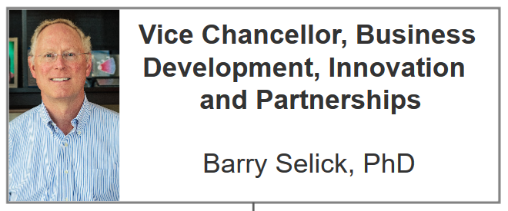
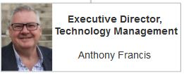
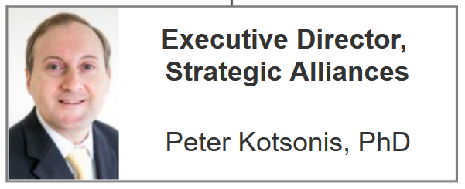
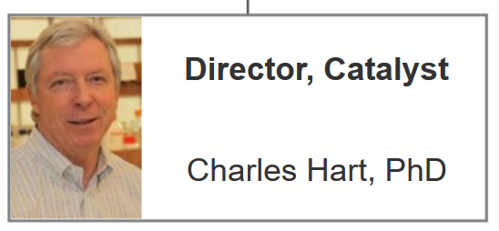
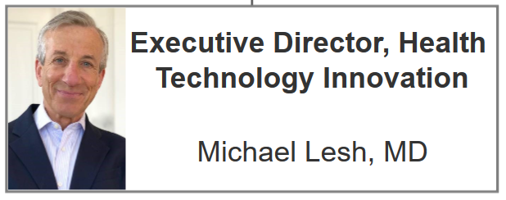
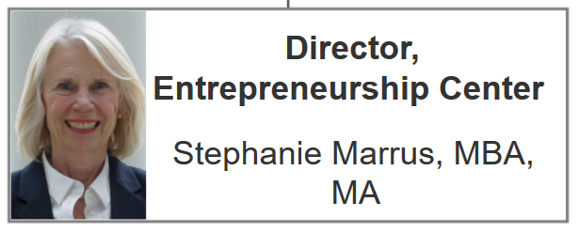
Innovation Ventures
Entrepreneurship Center

Slide 4
What it Takes to Succeed in a Startup
Product/market fit
Market size
Team
Entrepreneurship Center

Slide 5
Work on a Class Team Focused on an Idea
Entrepreneurship Center
Notes:
Entrepreneur mag

Slide 6
Entrepreneurship Center

Slide 7
Curriculum
Opportunity Recognition
Customer Discovery
Business Planning/Business Models
Investor requirements
Sector specific briefing
Entrepreneurship Center

Slide 8
Curriculum
IP and Corporate Legal
Clinical/Regulatory
Insurance Reimbursement
Team building
Finance
Sources of Capital
Pitching
Entrepreneurship Center

Slide 9
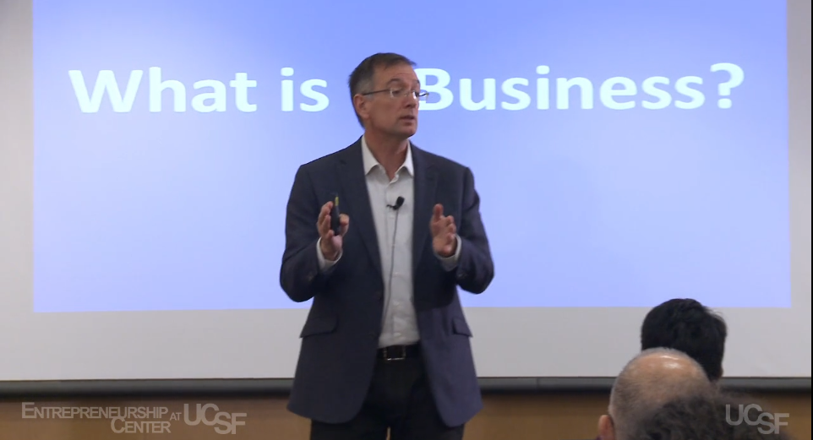
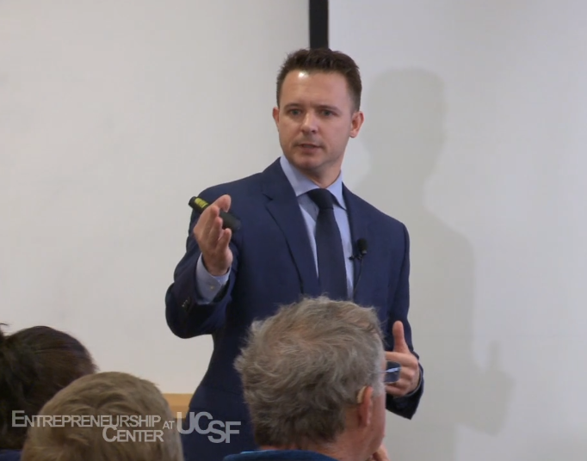
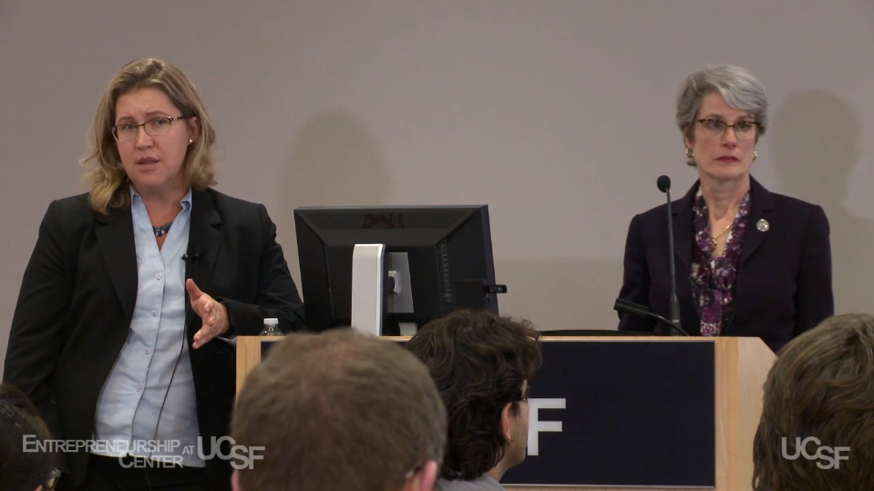
Guest Lecturers
CEOs
Investors
Entrepreneurs
Attorneys
Consultants
Entrepreneurship Center

Slide 10
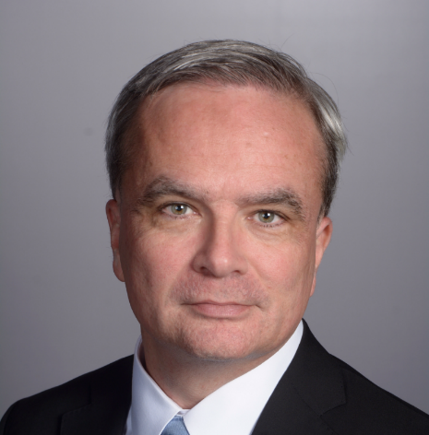
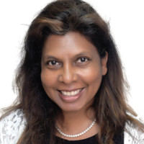
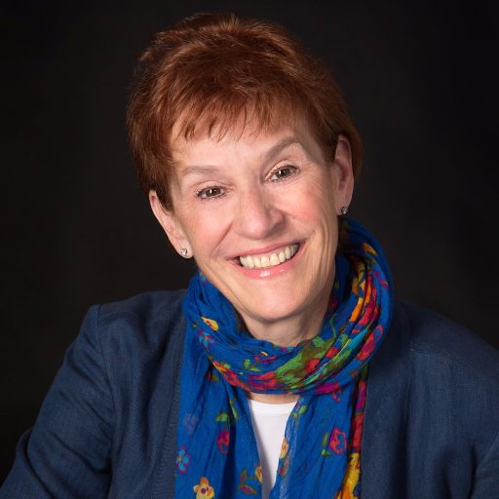
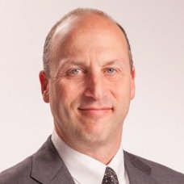
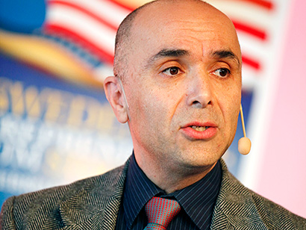
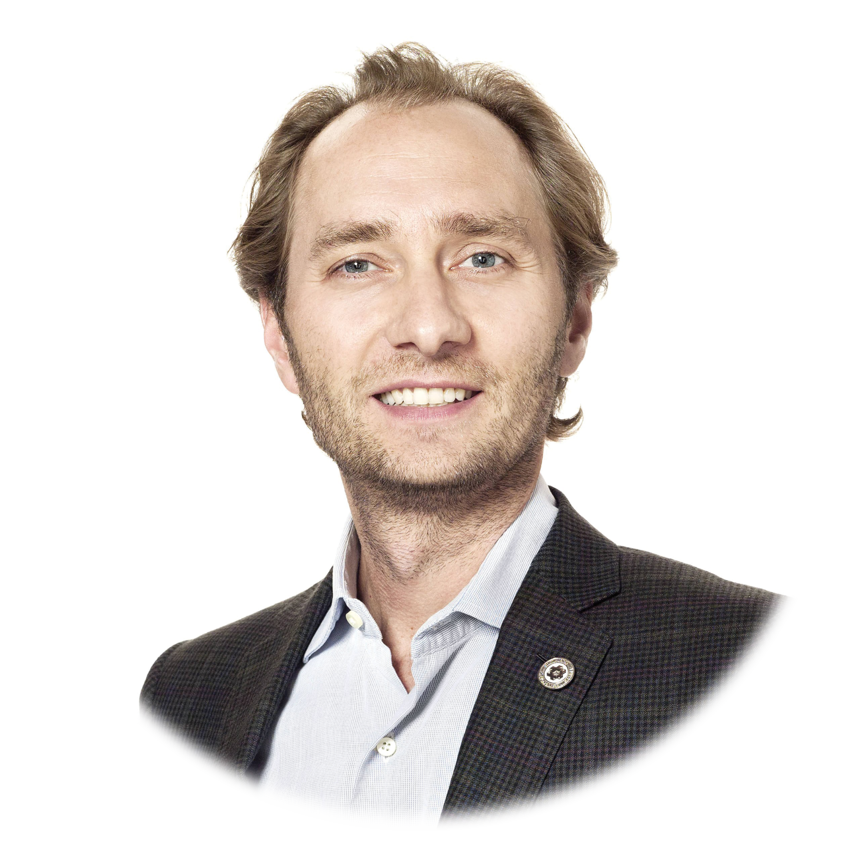
Class Advisory Committee
Tania Fernandez, PhD
President and Founder, Midissia Therapeutics , Dreamcatcher Ventures
Philippe Nore, MBA, MSc Vice President, Research and Business Development, Adaptive Biotechnologies
Chris Meda, MS
Chief Business Officer, IncellDx
Diagnostics
Diagnostics
Therapeutics
Faz Bashi, MD
Life Science Angels
Unity Stoakes
CoFounder, President,
Managing Partner
Startup Health
Howard Edelman
Chief Executive Officer,
Advanced Resin Therapeutics
Digital Health
Medical Devices
Entrepreneurship Center

Slide 11
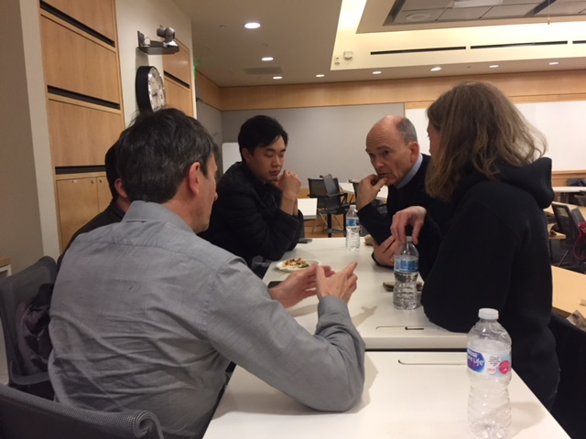
Experienced Life Science/Healthcare Business Mentors 1-2 Mentors per team
Entrepreneurship Center
Notes:
Stand and applause

Slide 12
Understand Investor Needs
Entrepreneurship Center

Slide 13
Get Out of the Building: 20 Interviews
Entrepreneurship Center

Slide 14
Understanding Your Value Proposition
Entrepreneurship Center

Slide 15
Talk to Users
Entrepreneurship Center

Slide 16
Talk to Payers
Entrepreneurship Center

Slide 17
Understand the Problem
Entrepreneurship Center

Slide 18
Look for Product/Market Fit
Entrepreneurship Center

Slide 19
Can you save the System $$?
Entrepreneurship Center

Slide 20
20+ customer discovery interviews
Executive summary
Pitch deck
Entrepreneurship Center

Slide 21
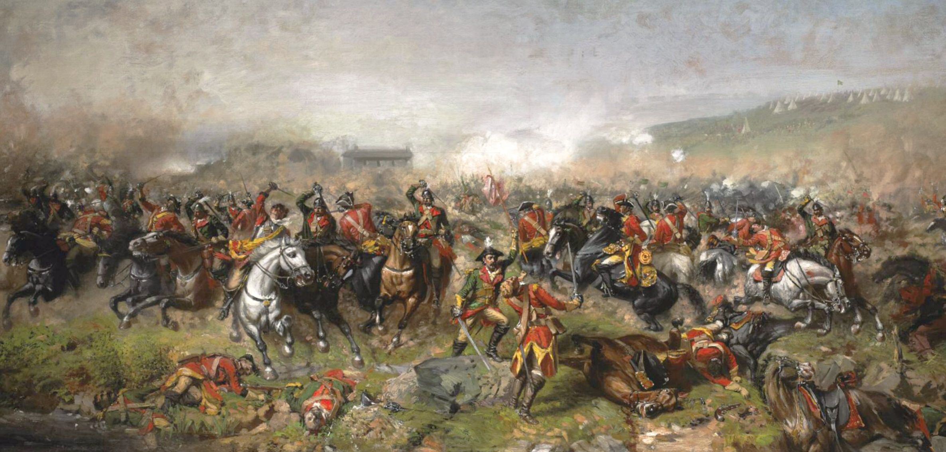
Competition for Pitch Night
Entrepreneurship Center

Slide 22
2019 Judges
Carl Bouthillette, ﻿MBA, Screening Committee Chair
Karl Handelsman, MBA, Investment Director, Roche Ventures/Genentech
David Morris, MD, Managing Director, Novartis Venture Fund
Carolyn Ng, PhD, Managing Director, Vertex Ventures, Temasek Holdings
Alex Szidon, PhD, Head, West Coast Business Development & Licensing, Merck
Armen Vidian, MSc, Operating Partner, Data Collective
Entrepreneurship Center
Notes:
Overall, idea, market opp, presentation. Is this investable. Are you interested in tracking.
Range from seed/angel to accelerator, CVC, sovereign wealth vc and regular vc’s.

Slide 23
Pitch Night Prize: Band of Angels Mentor Day Slots Top 2 teams
Entrepreneurship Center

Slide 24
Startup 101 is Having Impact
Entrepreneurship Center

Slide 25
Entrepreneurship Center Startups*
* Interacted with EC
Entrepreneurship Center

Slide 26
Teams Accepted by Top Accelerators
Entrepreneurship Center

Slide 27
Thaddeus Allen, PhD Tradewind Biosciences Y-Combinator (YC W18)
Entrepreneurship Center

Slide 28
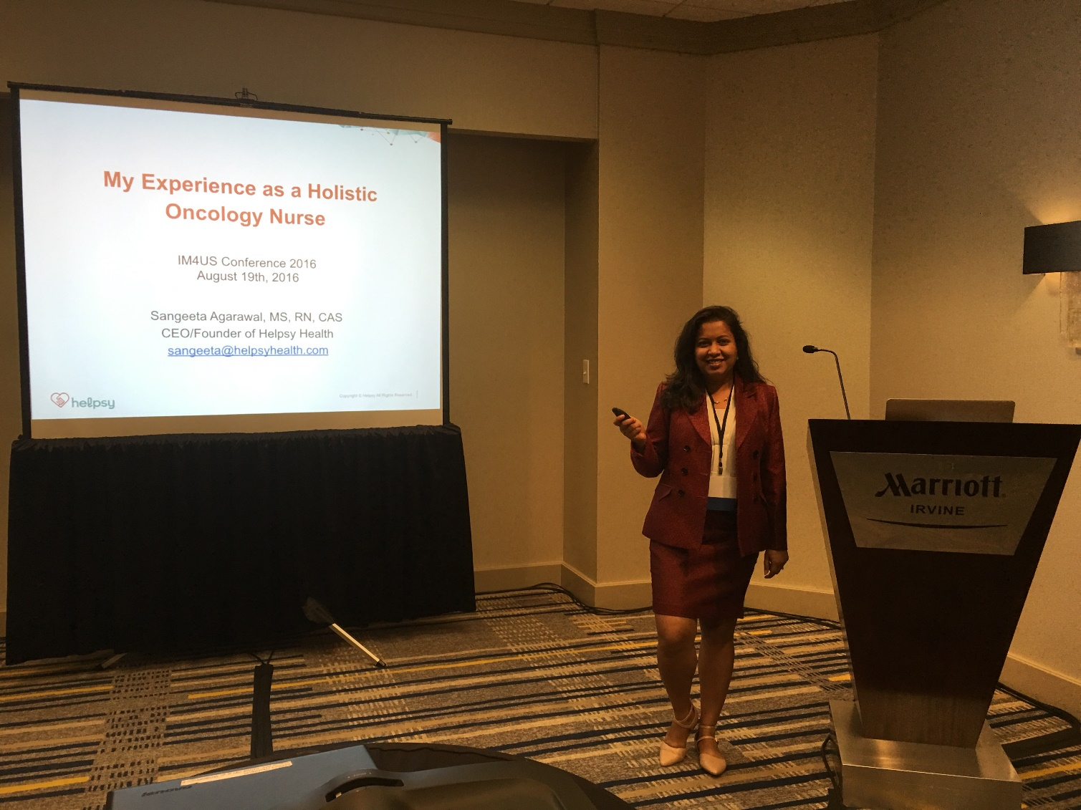
Sangeeta Agarawal, MS
Helpsy Health
Plug N Play (Fall 2018)
Entrepreneurship Center

Slide 29
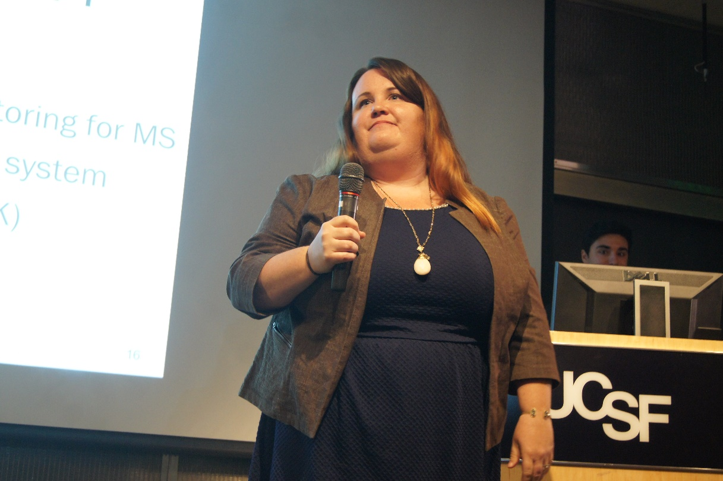
Christy Sheehy, PhD C.Light Technologies Berkeley Skydeck (Fall 2019 cohort)
Entrepreneurship Center

Slide 30
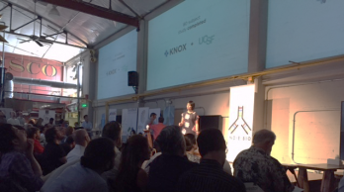
Charvi Shetty Aluna IndieBio
Entrepreneurship Center

Slide 31
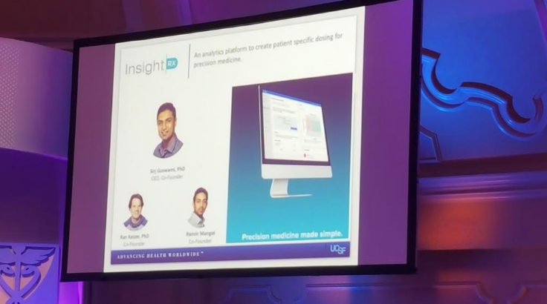
Sirj Goswami, PhD
Insight Rx
LaunchPad Digital Health
Raised $10MM Series A 2019
Entrepreneurship Center

Slide 32
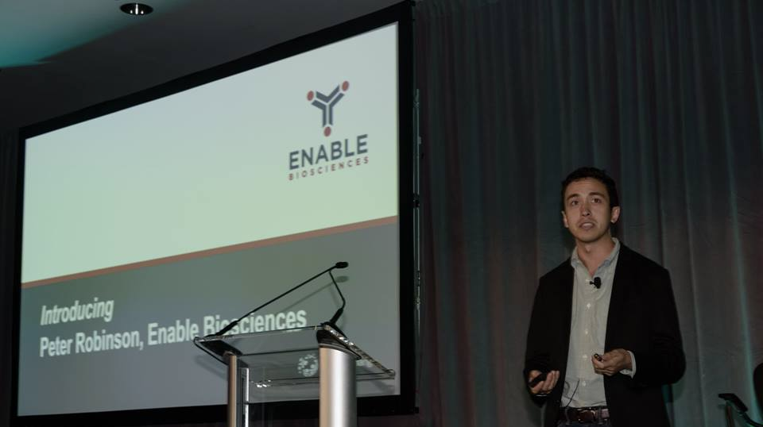
Peter Robinson, PhD
Enable Biosciences
Stanford StartX
Entrepreneurship Center

Slide 33
Our Startups are Getting Funded
37 companies
Over $300 MM raised
Raised $59MM
EC affiliation 2013-18
Entrepreneurship Center
Notes:
4 years, cos. touched. By EC

Slide 34
Schedule
Thursday nights + 3 Mondays
January 23 – April 9; 11 weeks
5:30 -8:00 pm
Mission Bay campus
Entrepreneurship Center

Slide 35
Deliverables
2-3 page executive summary
Investor Pitch Deck
20 customer discovery interviews
Entrepreneurship Center

Slide 36
Application
Deadline 12/12: https://forms.gle/dGEQ7f96BbLhdAr3A
Application with team identified stronger
Need at least 1 UCSF member
Entrepreneurship Center

Slide 37
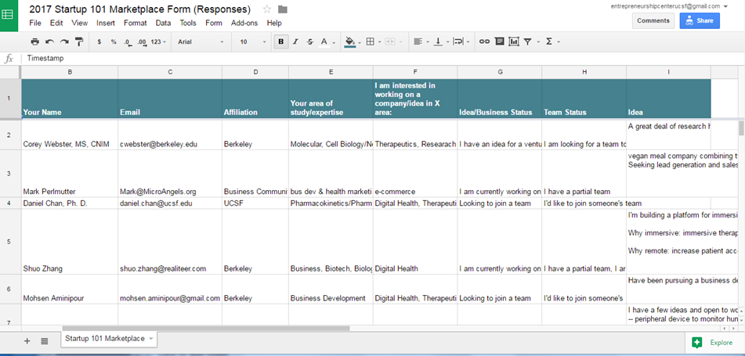
Find Team Members on Marketplace https://forms.gle/6WAYgo8aAAtwzkEx9
View Response Sheet: bit.ly/2PY0C7V
Entrepreneurship Center

Slide 38
No Fees for UCSF/UCB Students/Post Docs, Faculty
Entrepreneurship Center

Slide 39
Fee Schedule for Others
See Course Syllabus 2020
Entrepreneurship Center

Slide 40
Class Alum: Adam Foye
Entrepreneurship Center

